Slide 1
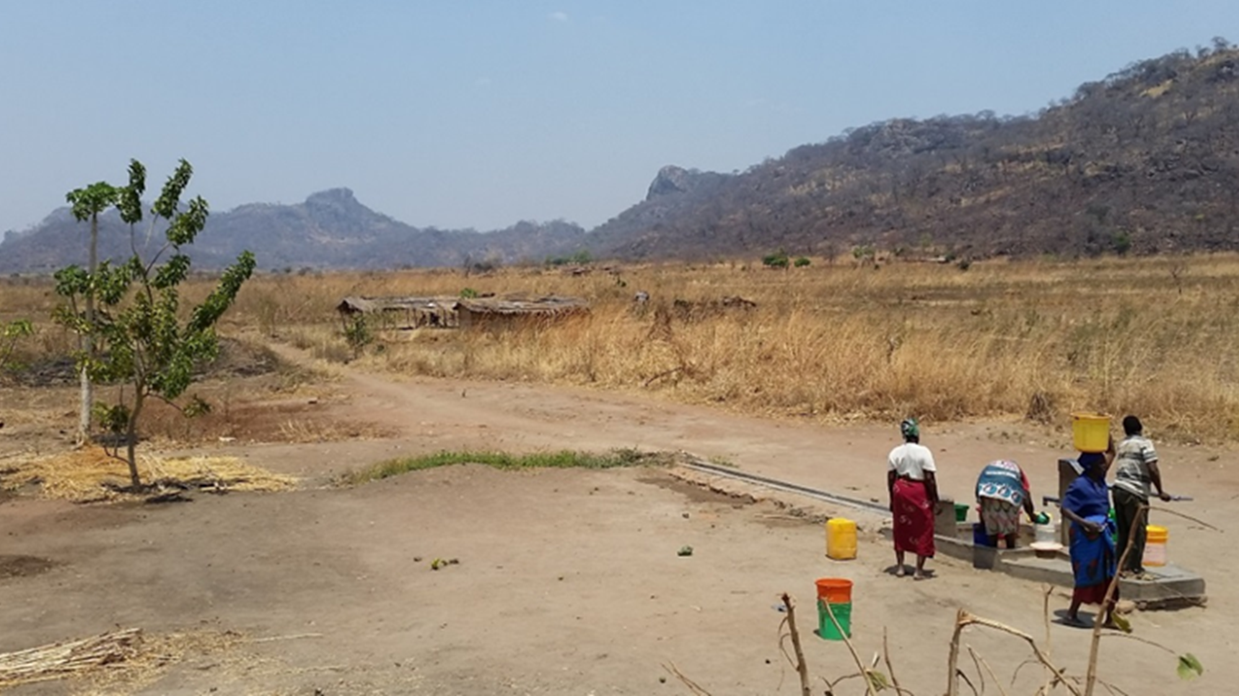






Rapid screening for pathogens in drinking water: preliminary results from a national scale survey in Malawi
Jade Ward, Dan Lapworth, Gloria Gwengweya, Alan MacDonald, Steve Pedley, Dan Read
Notes:
I’m here to present preliminary results of research undertaken in Malawi, investigating a rapid screening method for detecting pathogens in drinking water supplies.
I have undertaken this research as part of my PhD at the university of Surrey and have been working in collaboration with the British Geological Survey, the UPGro Consortium, the University of Malawi and the REACH Programme

Slide 2








Estimated that at least 1.8 billion people worldwide drink from a faecal-contaminated water source, which resulted in 502,000 deaths from diarrhoeal diseases in 2012
(WHO 2016)
Why measure water quality?
Sustainable Development Goal 6:
“Ensure availability and sustainable management of water and sanitation for all”
http://www.clker.com/cliparts/I/g/O/k/0/b/red-stick-figure-hi.png
http://www.clker.com/cliparts/m/i/V/n/p/E/stick-man.svg
Notes:
Emphasise faecal contamination aspect of waterquality
There is a need to monitor water quality effectively to work towards SDG 6
Not restricted to developing countries only but they are most at risk, my focus is on sub Saharan Africa
2.4 billion people lack access to basic sanitation facilities = 280,000 deaths in 2012

Slide 3
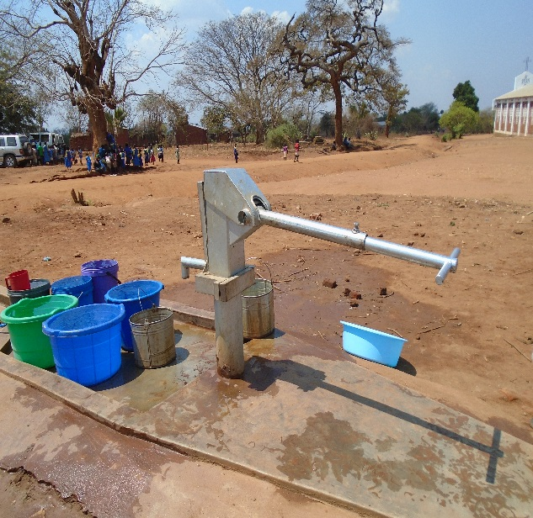
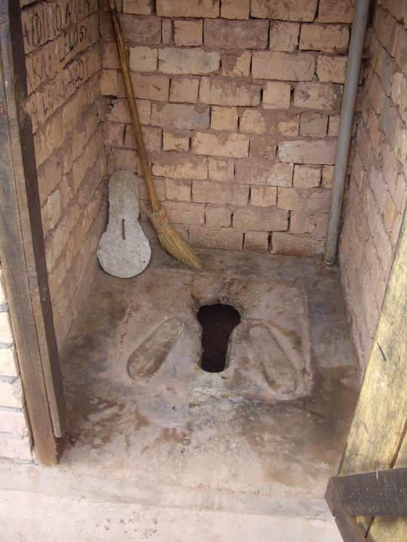
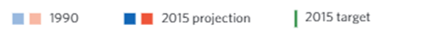
Water quality in Sub-Saharan Africa
Sub-Saharan Africa failed to meet the millennium development goals targets
By 2015:
68% of the population had access to an improved water source
30% of the population had access to improved sanitation facilities
1990
2015
http://imgarcade.com/pit-latrine.html
Notes:
MDGs not met in SSA
Importance of groundwater

Slide 4
Study Area – Rural Malawi
Dry season 2016
5 districts
182 drinking water sources
End of wet season 2017
2 districts
40 drinking water sources
Notes:
This study took place in Malawi, with sampling carried out in 5 districts in the dry season of 2016, this time last year. A total of 221 sources were selected but only 182 were functional – some of the hand pumps were broken or abandoned
The districts were selected to ensure a range of aquifers and poverty levels, and the water sources within each district were randomly selected
40 sites were revisited at the end of the wet season in March and April this year

Slide 5
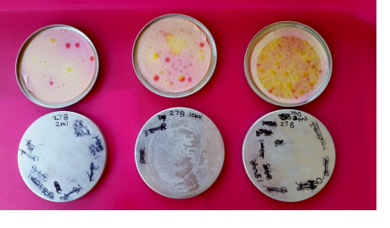
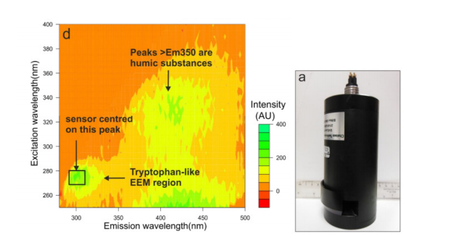
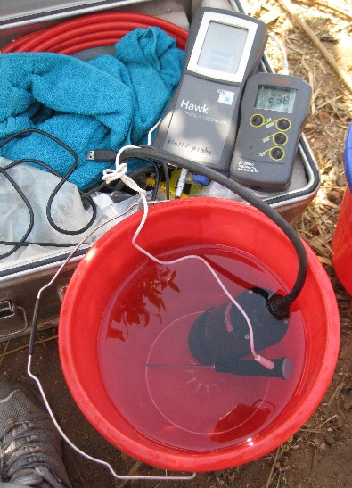
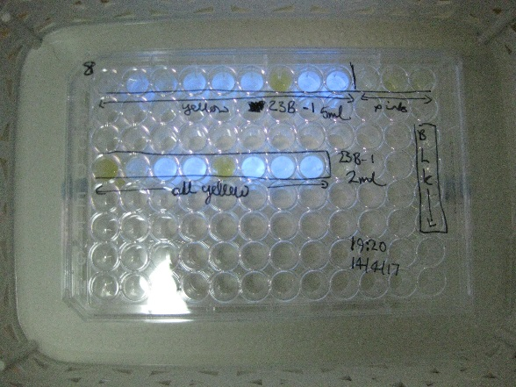
Detecting microbial contamination
Established methods
Culturing thermotolerant coliforms
2. Testing presence of E. coli
Emerging technology
Fluorimeter measuring Tryptophan-like fluorescence
Notes:
A fluorimeter was used for rapid detection of pathogens, which detects tryptophan-like fluorescence. Tryptophan is an amino acid that fluoresces within this specific range (point).
It has been widely used in surface water for identifying contaminant plumes, with a more recent application to groundwater drinking water supplies.
Advantages of this method are that is it easily portable, quick and easy to use without the requirement of a lab or consumable equipment.
However studies conducted so far have generally been on a small scale in the field, so this study is a significant contribution to the available datasets. There has been some investigation into the effects of some hydrochemical parameters on the fluorescence signal
________________________________________________
TTC culturing – recognised method and standard, TTCs assumed to be E coli, which are a easily culturable and often not pathogenic although there are some very pathogenic strains
Colilert to test if the TTCs were actually E coli as assumed by the method

Slide 6

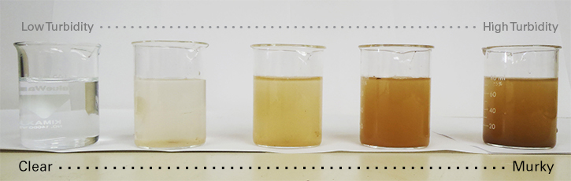
Factors influencing Tryptophan-like Fluorescence
Temperature –
thermal quenching
2. Turbidity –
interference with sensor
3. Coloured dissolved organic matter – interference with TLF peak
Notes:
Khamis et al 2015 – lab study with T standards – lowest being 10ppb
1. Temperature – lab studies on pure L-Tryptophan
show thermal quenching above a certain temp
Likely NA in groundwater b/c fairly stable temp
in comparison to surface water sources
Higher temperature
increases collisional quenching and thus the chance that an excited electron will return to the ground energy state via a radiationless pathway
_________________________________________________________
3. Turbidity – could reduce TLF signal by interference
High turbidity increases the scattering of light and can physically block fluorescence if turbid enough
but likely NA in groundwater –as stated by Khamis et al 2015
_______________________________________________________
2. DOC – bleedthrough to the TLF peak can occur if DOC is high
Is possible

Slide 7
Results - Temperature
Notes:
Temperature
Small range = stable all year round, common characteristic of groundwater
TLF shows no trend in association with Temp
Therefore indicates there is no temperature influence on data
This is expected due to the small temperature range and low values of tryptophan
Previous study showed good correlation between lab and field data
In addition temperature was most influential for high values of tryptophan – values tested were 10 ppb upwards

Slide 8
Results - Turbidity
Notes:
Generally low turbidity, with all but 1 source less than 100 NTU.
Turbidity not a concern in majority of groundwater sources in relation to interference with TLF,
However, 1 source with a value of 518 NTU is likely to have a surpressed Tryptophan signal, because using a traditional culturing method 600 thermotolerant colonies were grown, indicating contamination of the source. This would be expected as the source was an unlined shallow well
This is an exceptional turbidity reading for groundwater and is clearly an outlier in this dataset, but it does show the importance of measuring turbidity alongside tryptophan fluorescence to ensure a valid result

Slide 9
Results – Coloured Dissolved Organic Matter - fluorimeter
Notes:
Some dilution in the wet season
Majority of points clustered around 18-21 mark
Bleed through likely to explain these outliers
At the low end there is Lots of scatter but a slight trend in increasing TLF with dissolved organic carbon. Unlikely to be significant?

Slide 10
Results – Dissolved Organic Carbon – laboratory analysis
Notes:
DOC vs TLF = lots of scatter but positive trend
CDOM vs DOC = trend only in 4 outliers. DOC varies much more than CDOM measured by fluorimeter
Therefore the fluorescence of the DOC/CDOM is not interfering with the TLF???

Slide 11
Factors influencing Tryptophan-like Fluorescence
Temperature –
thermal quenching
2. Turbidity –
interference with sensor
3. Coloured dissolved organic matter – interference with TLF peak

Slide 12
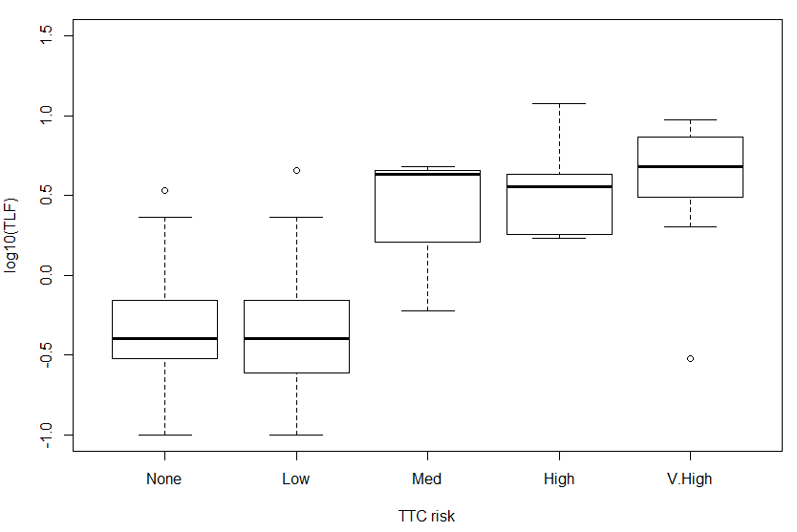
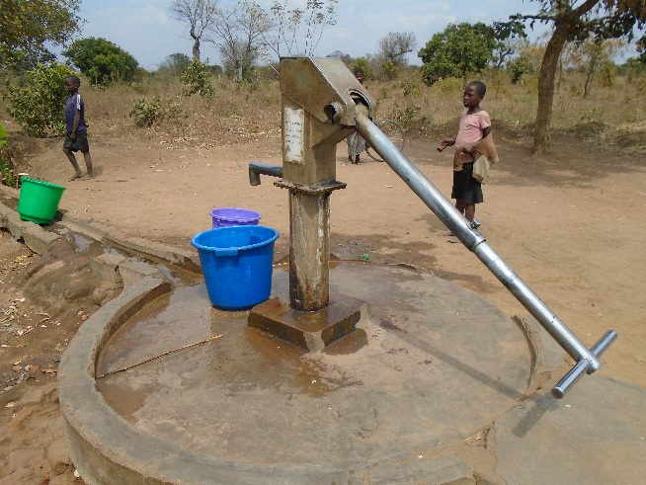
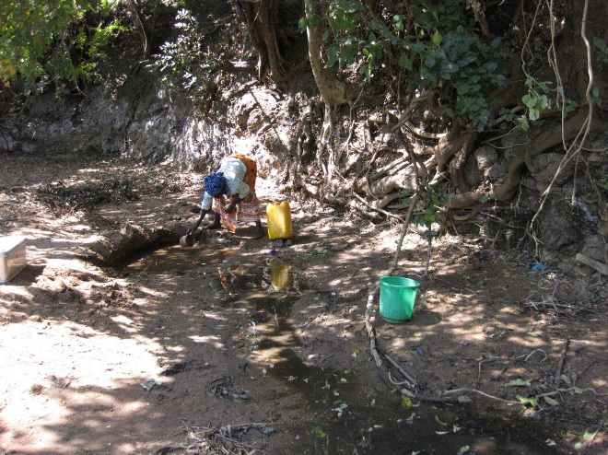
Results – Comparison with culturing method
Notes:
• TLF increases with increased TTC presence despite some scatter;
• TLF signal differs significantly (P=<0.001) between sites with and without TTC presence. The false positive rate is 20% and false negative rate is 10%. This suggests TLF has potential to screen for contamination but requires some refinement;
• Elevated TLF signal at sources with no or low TTC counts could be attributable to the presence of non-culturable cells due to environmental conditions, which means TLF could be a more sensitive indicator of bacterial contamination than TTC culturing;
• A high TTC count and low TLF signal at one source was shown to be due to TTC not being E. coli (an assumption of the TTC method);
• TLF detected a significant (P=<0.001) difference between the TTC WHO health risk categories for no and low risk when compared with high and very high risk categories.
• TLF did not detect a significant difference between no, low and medium risk categories. This is likely to be influenced by a small sample size (n=3) for the medium risk category,the small size of the no risk category (0 TTCs only) and inherent variability culturing TTCs.
This study concludes that TLF has potential to be developed as a rapid screening tool for identifying contamination in drinking water, however a better understanding of the factors influencing TLF and the inherent variability of the TTC method is needed to reduce false positives and negatives.
Further work includes re-sampling sources in the wet season, where compartment bag tests and Colilert were used to identify E. coli contamination specifically and the proportion of TTCs that were E coli, in addition to repeat TLF sampling and TTC culturing. Future work is planned to investigate the variability within the TTC method.

Slide 13
Conclusions
Temperature, turbidity and dissolved organic carbon measurements should always be recorded when using TLF
Temperature stability of groundwater suits the application of TLF
Low turbidity of groundwater suits the application of TLF
Coloured dissolved organic carbon fluorescence does not typically influence TLF readings
In cases of exceptionally high turbidity and variable CDOM readings, more detailed microbiological analysis should be undertaken.

