Slide 1
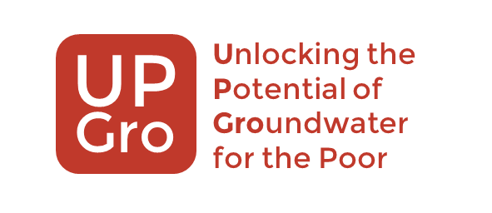
Africa Groundwater Atlas
Making African groundwater information more available
B Ó Dochartaigh, K Upton, A MacDonald, E Crane
British Geological Survey

Slide 2
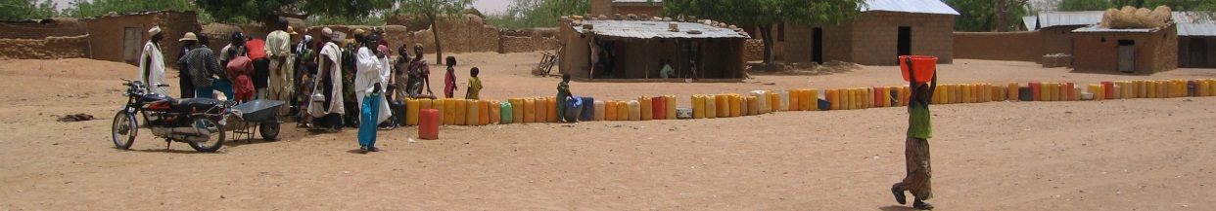
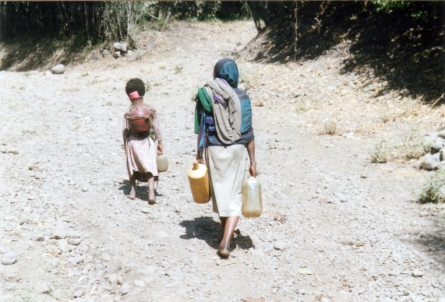
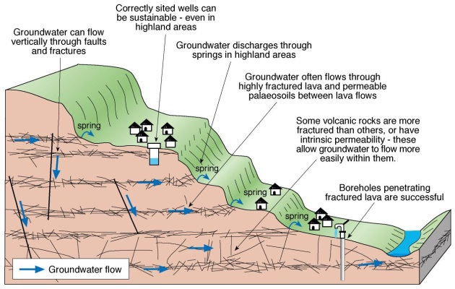
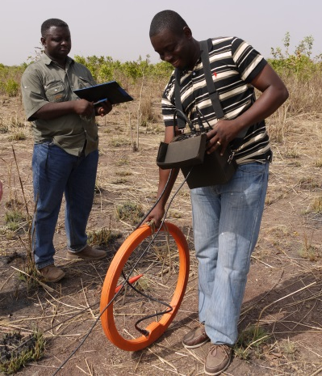
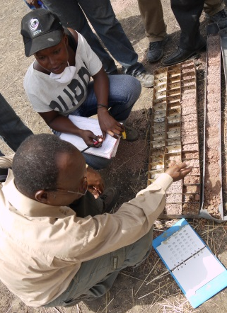
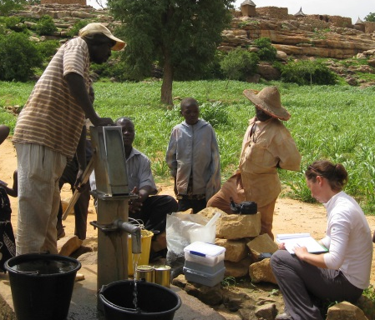
Why is the Atlas important?
A lack of robust groundwater information constrains safe, sustainable groundwater development in Africa.
BUT – lots of good information is out there – just not easily available & accessible

Slide 3
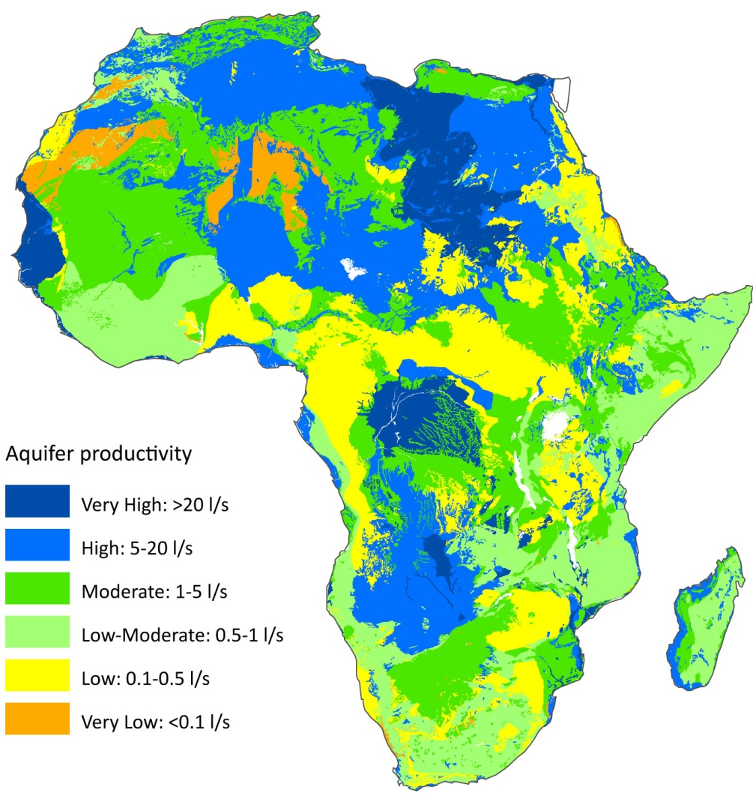
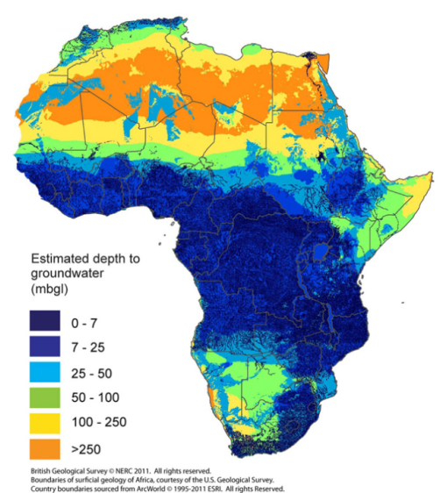
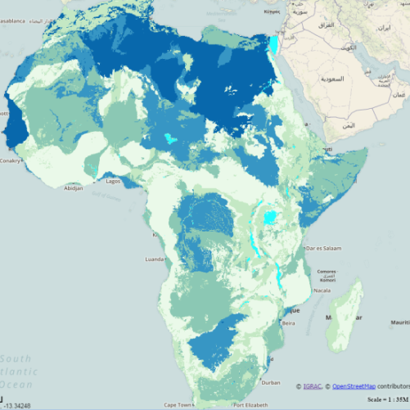
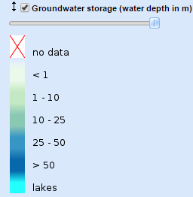
Quantitative groundwater maps of Africa
New maps of aquifer productivity, groundwater storage & depth to groundwater (ERL 2012) provided a continental-scale summary => enthusiastically received.
  Downloadable from BGS as digital GIS-enabled files
  Now also available in IGRAC’s Groundwater Resources in Africa viewer

Slide 4
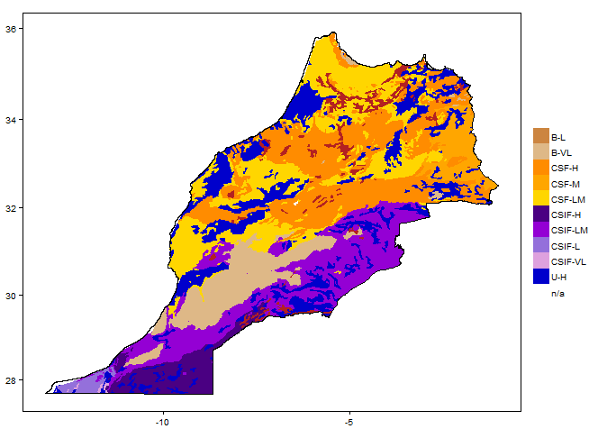
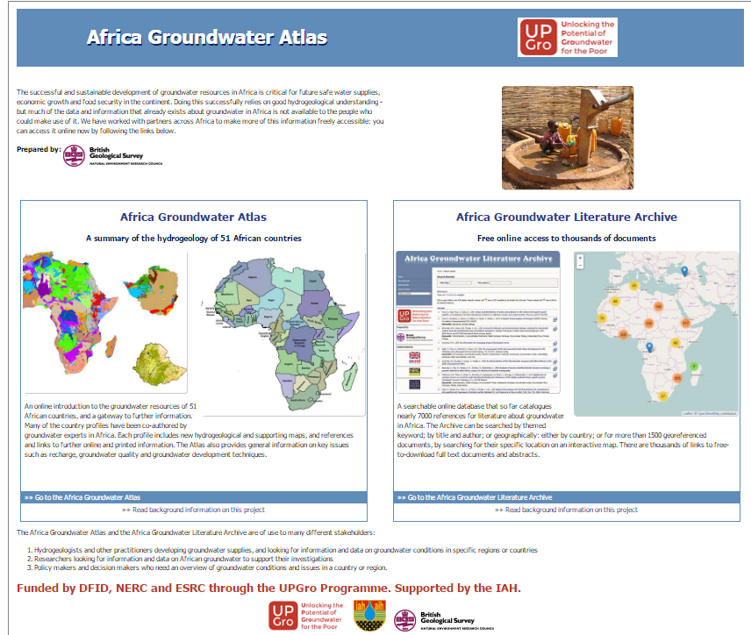
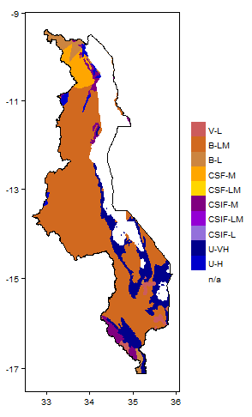
Consequent demand to increase resolution of groundwater information to country scale => development of the online Africa Groundwater Atlas
Includes the Africa Groundwater Literature Archive

Slide 5
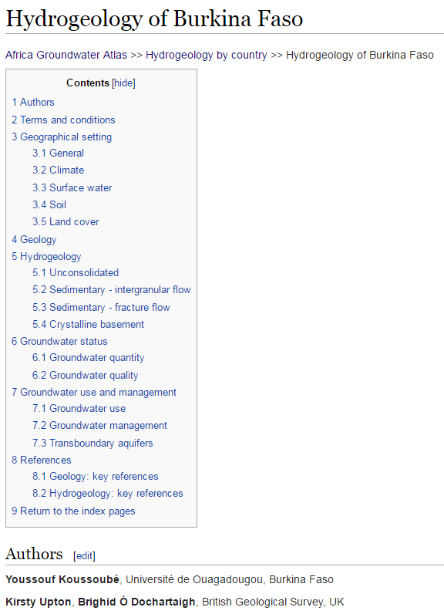
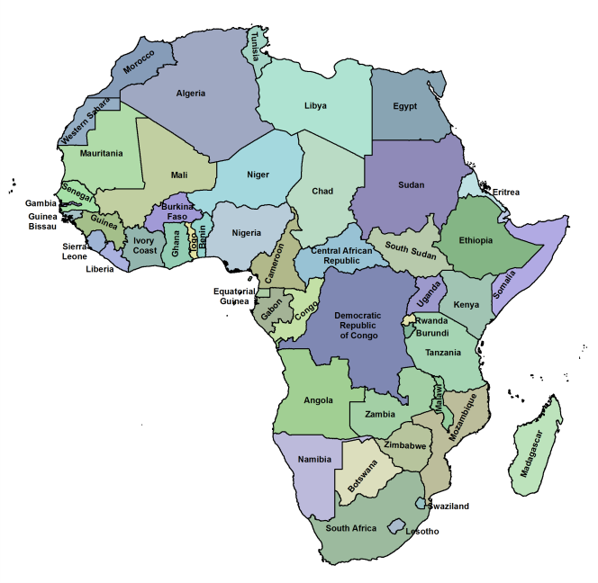
What is the Africa Groundwater Atlas?
A consistent overview of groundwater resources, key aquifers & their hydrogeology, groundwater status & management
Covers 51 countries
  Co-written with more than 50 hydrogeologists from across Africa

Slide 6
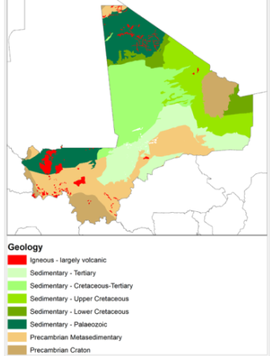
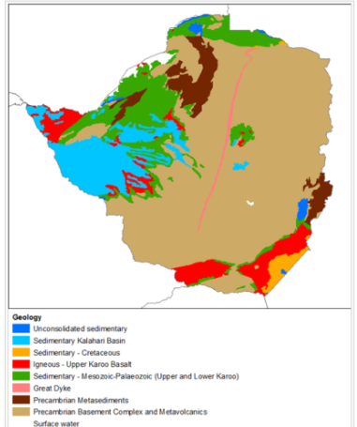
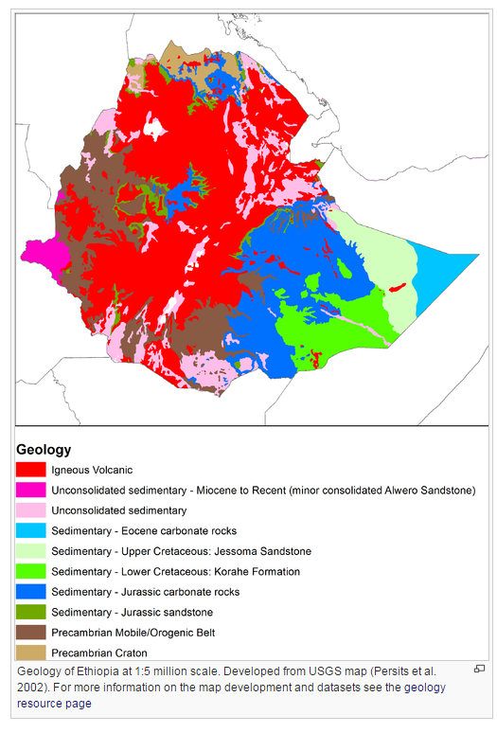
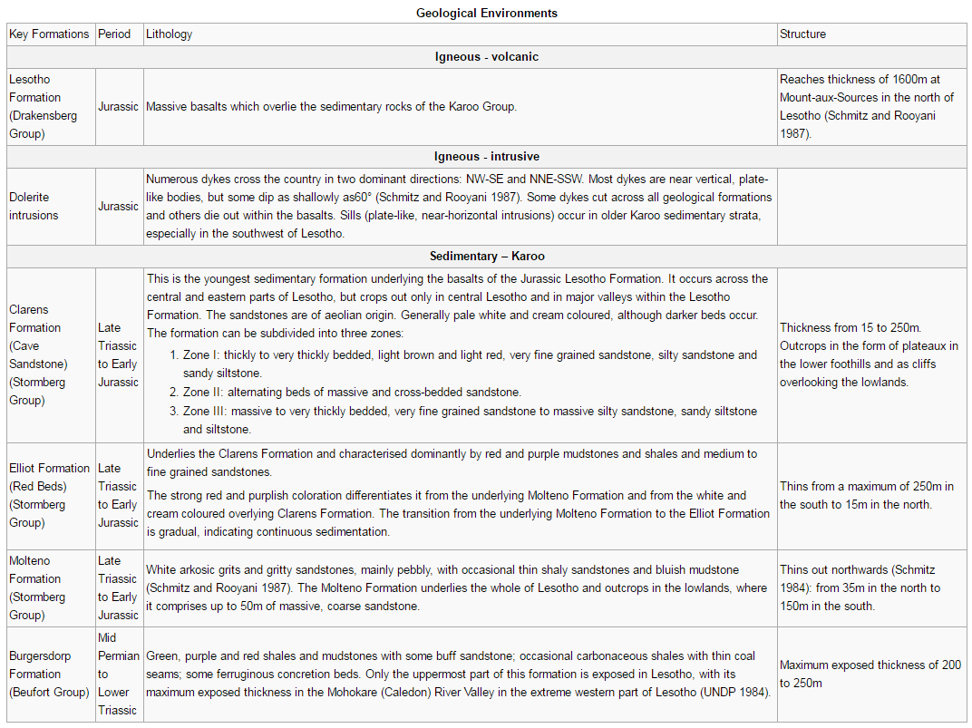
Maps updated using best available information
New country-scale geological maps
Consistent geological summaries of main formations

Slide 7
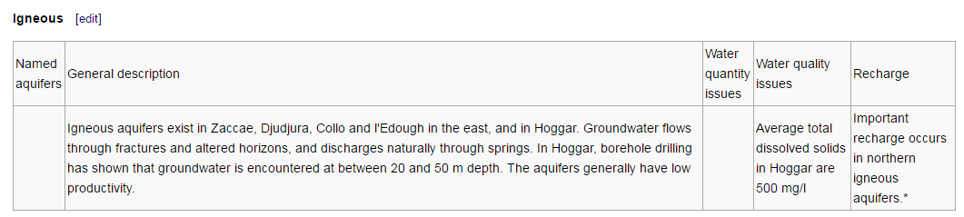
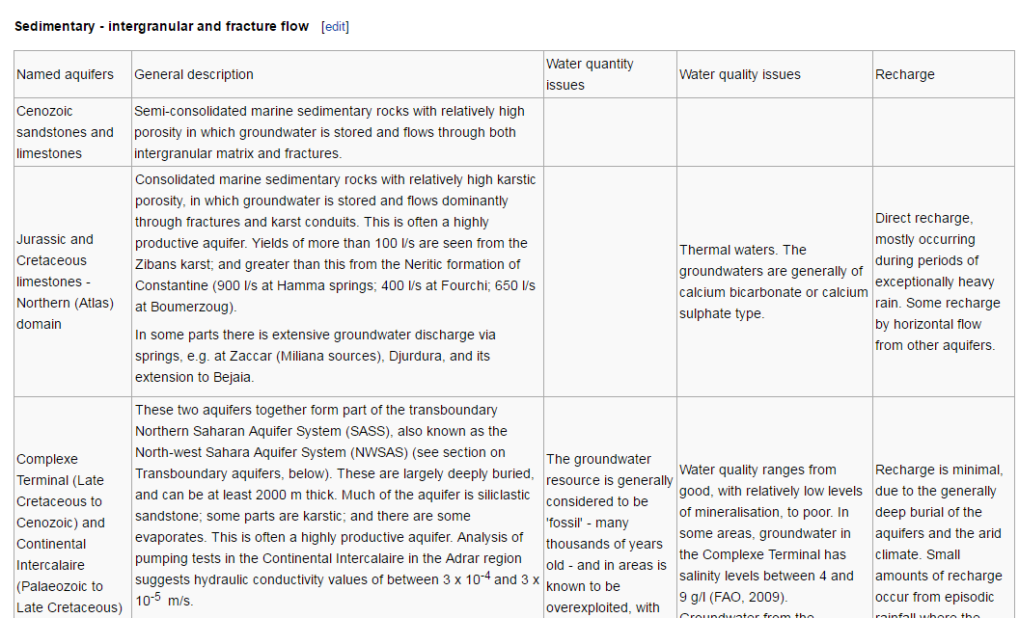
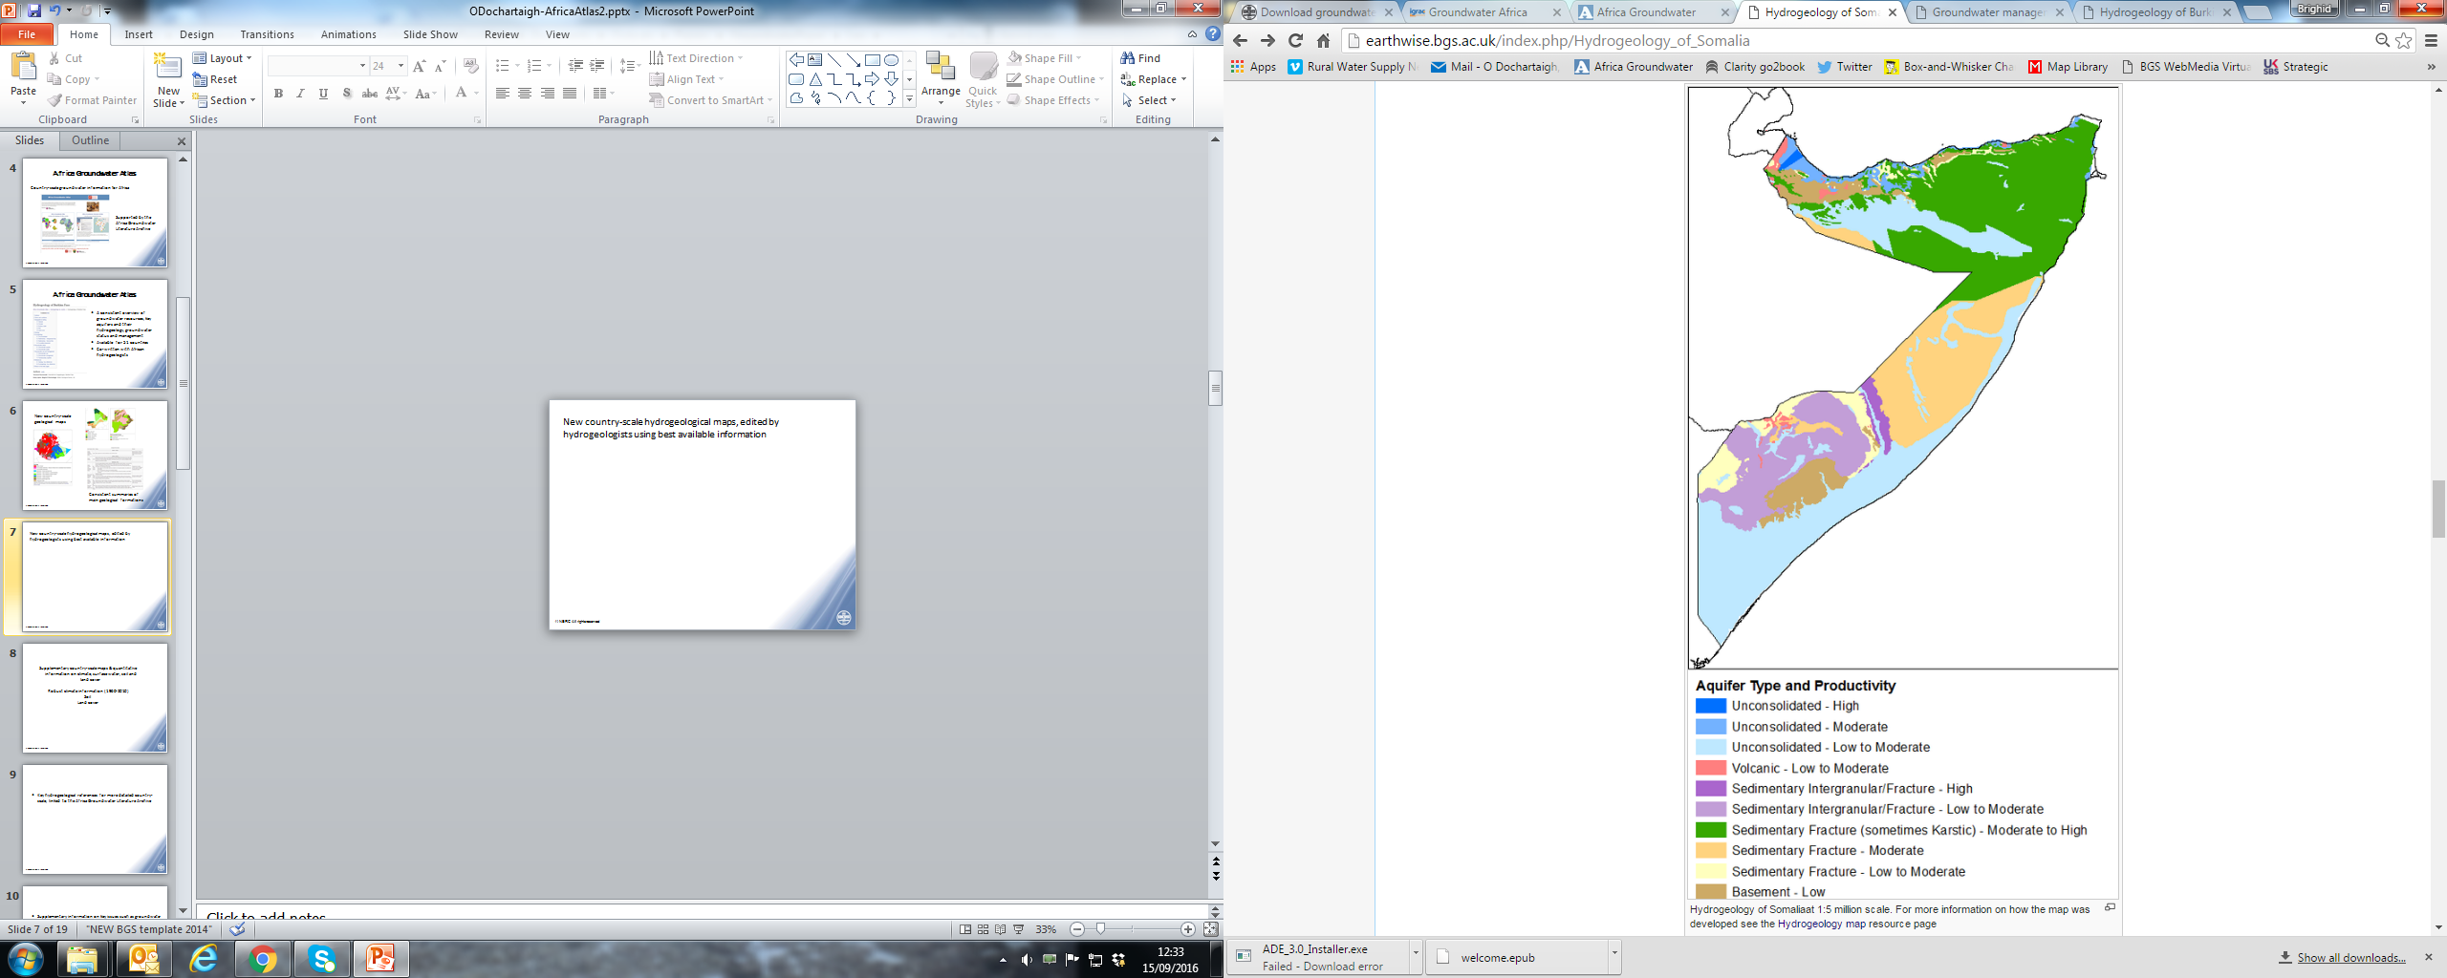
New country-scale hydrogeological maps
Maps updated by hydrogeologists using best available information
Consistent hydrogeological summaries of key aquifers

Slide 8
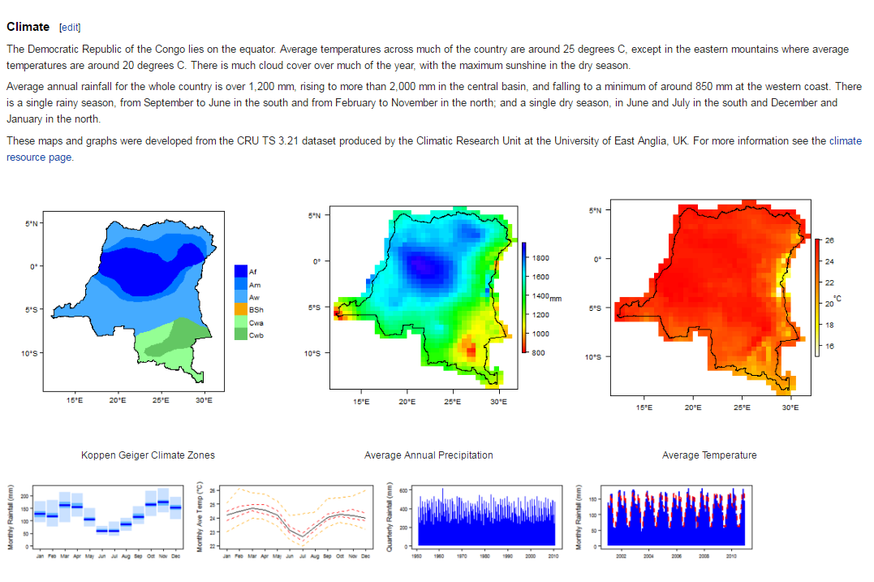
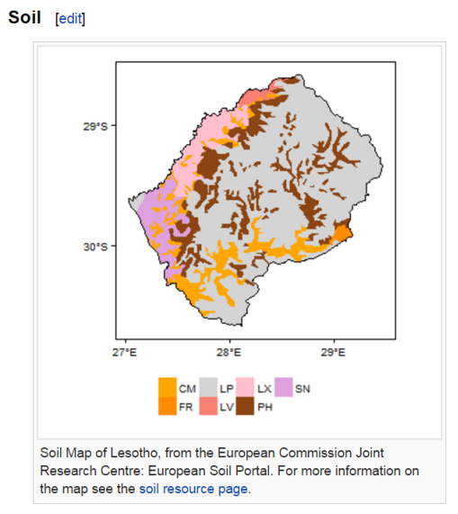
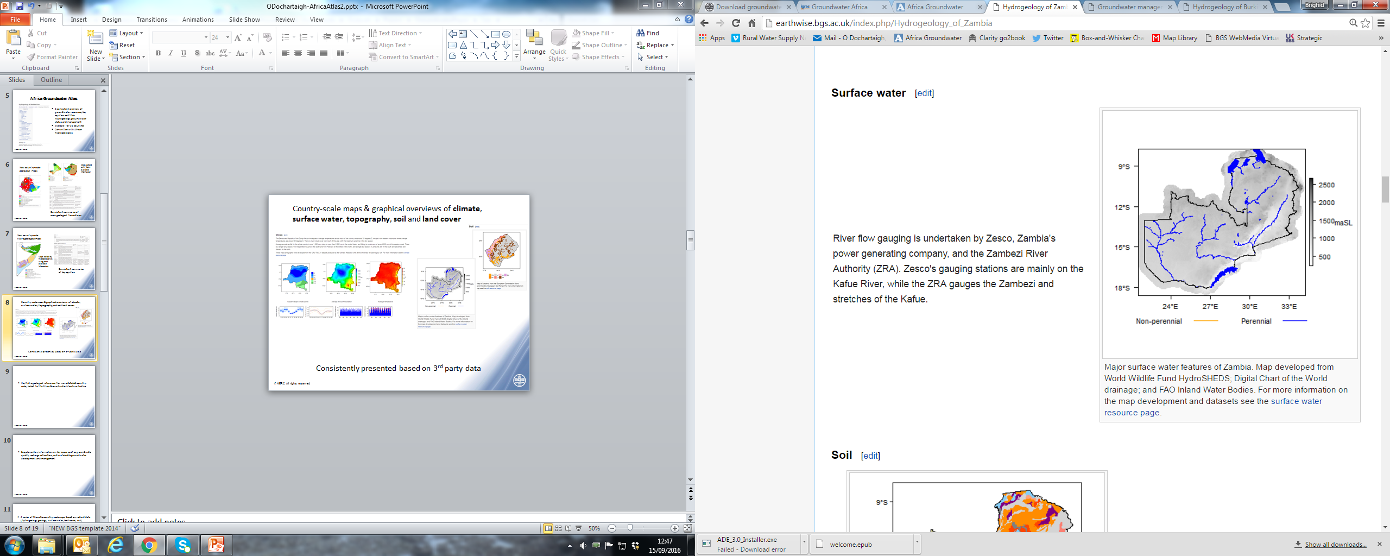
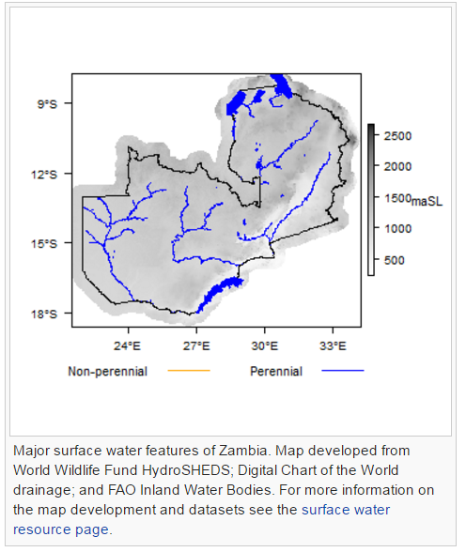
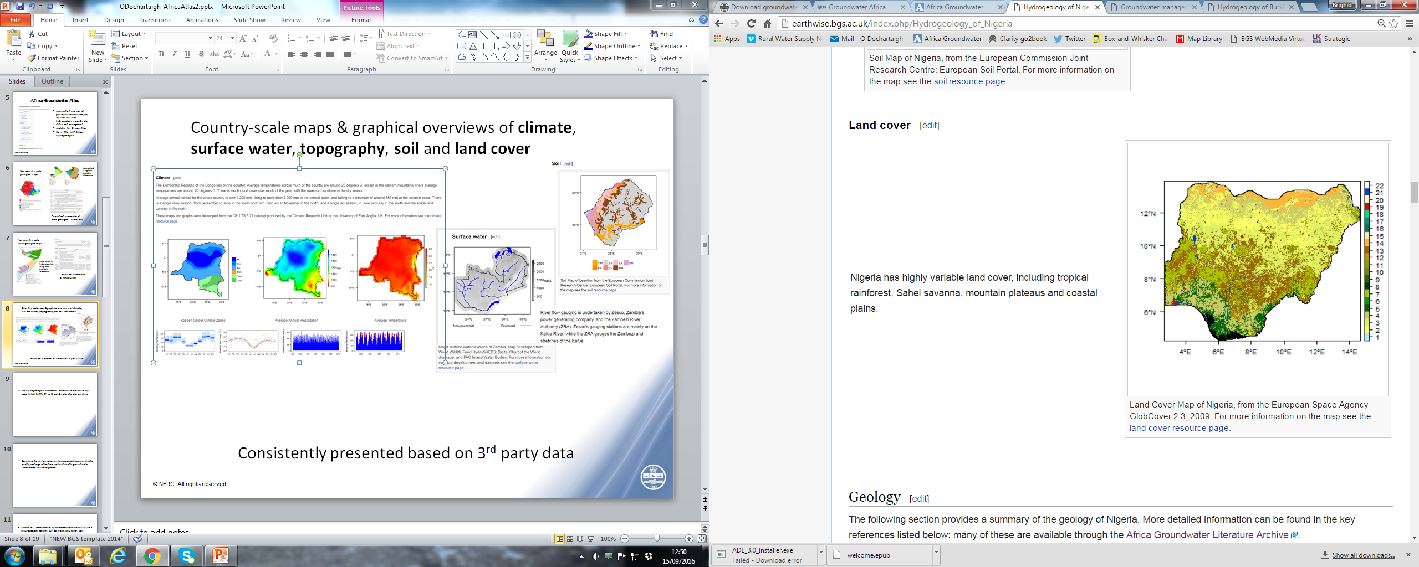
Country-scale maps & graphical overviews of climate, surface water, topography, soil & land cover
Consistently presented
Derived from 3rd party data

Slide 9
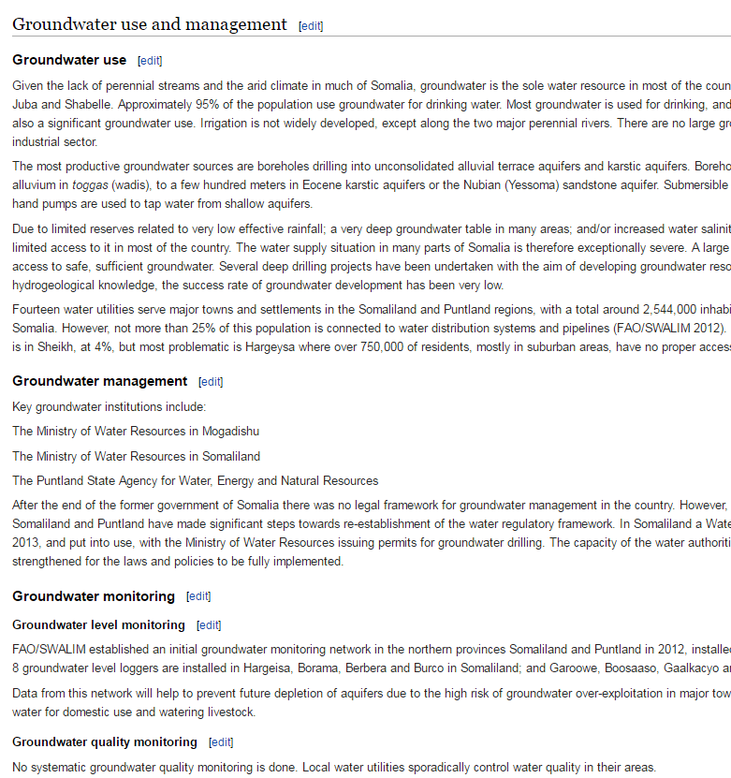
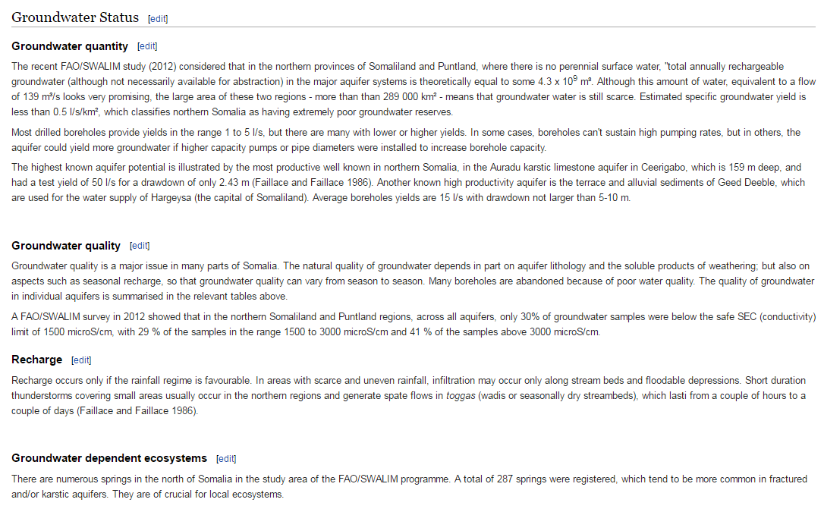
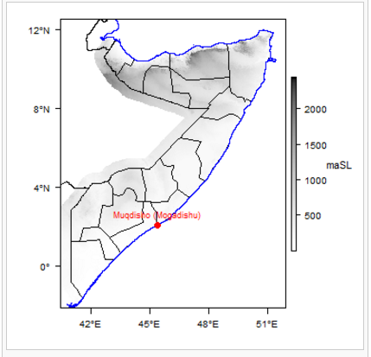
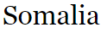
An overview of groundwater status, use & management in each country

Slide 10
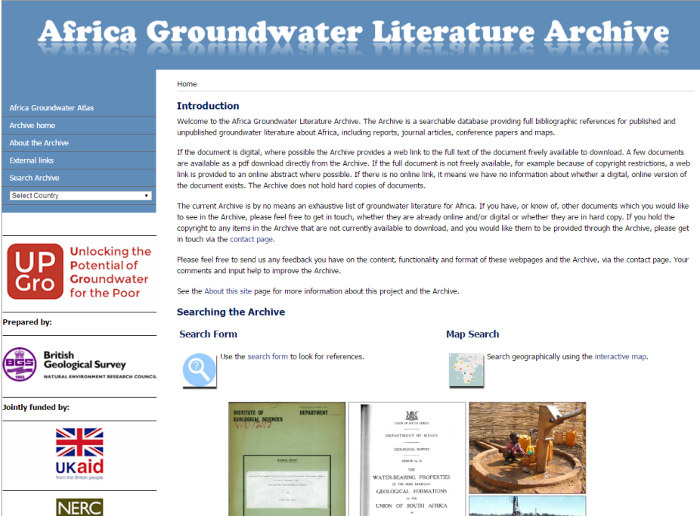
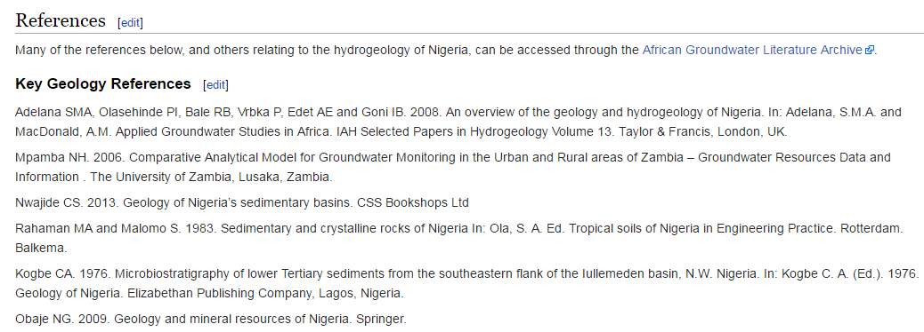
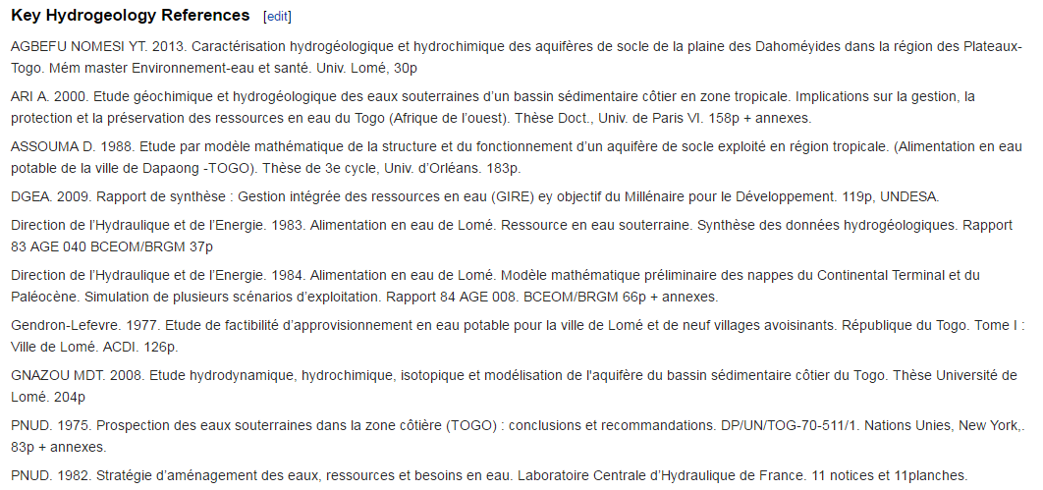
Key geological & hydrogeological references for more detailed country-scale information

Slide 11
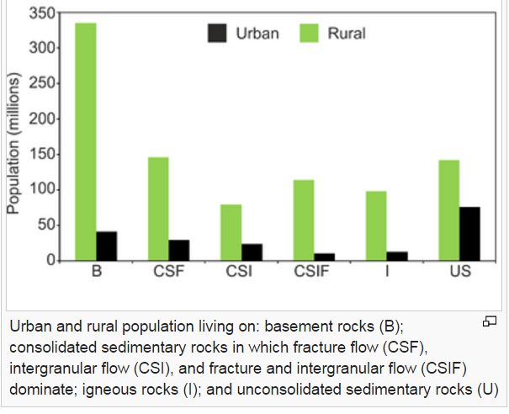
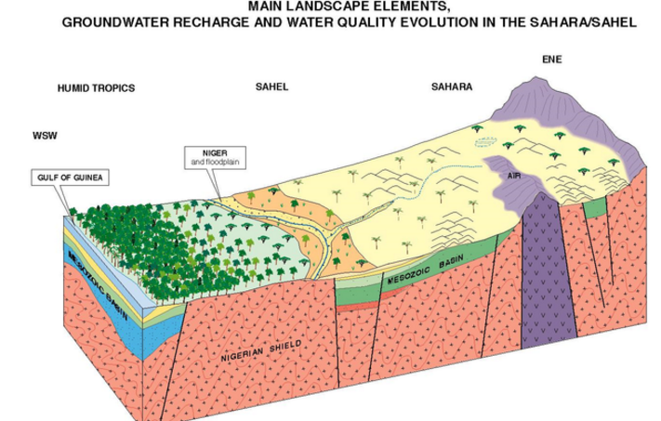
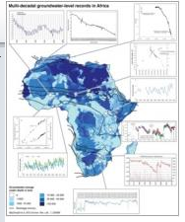
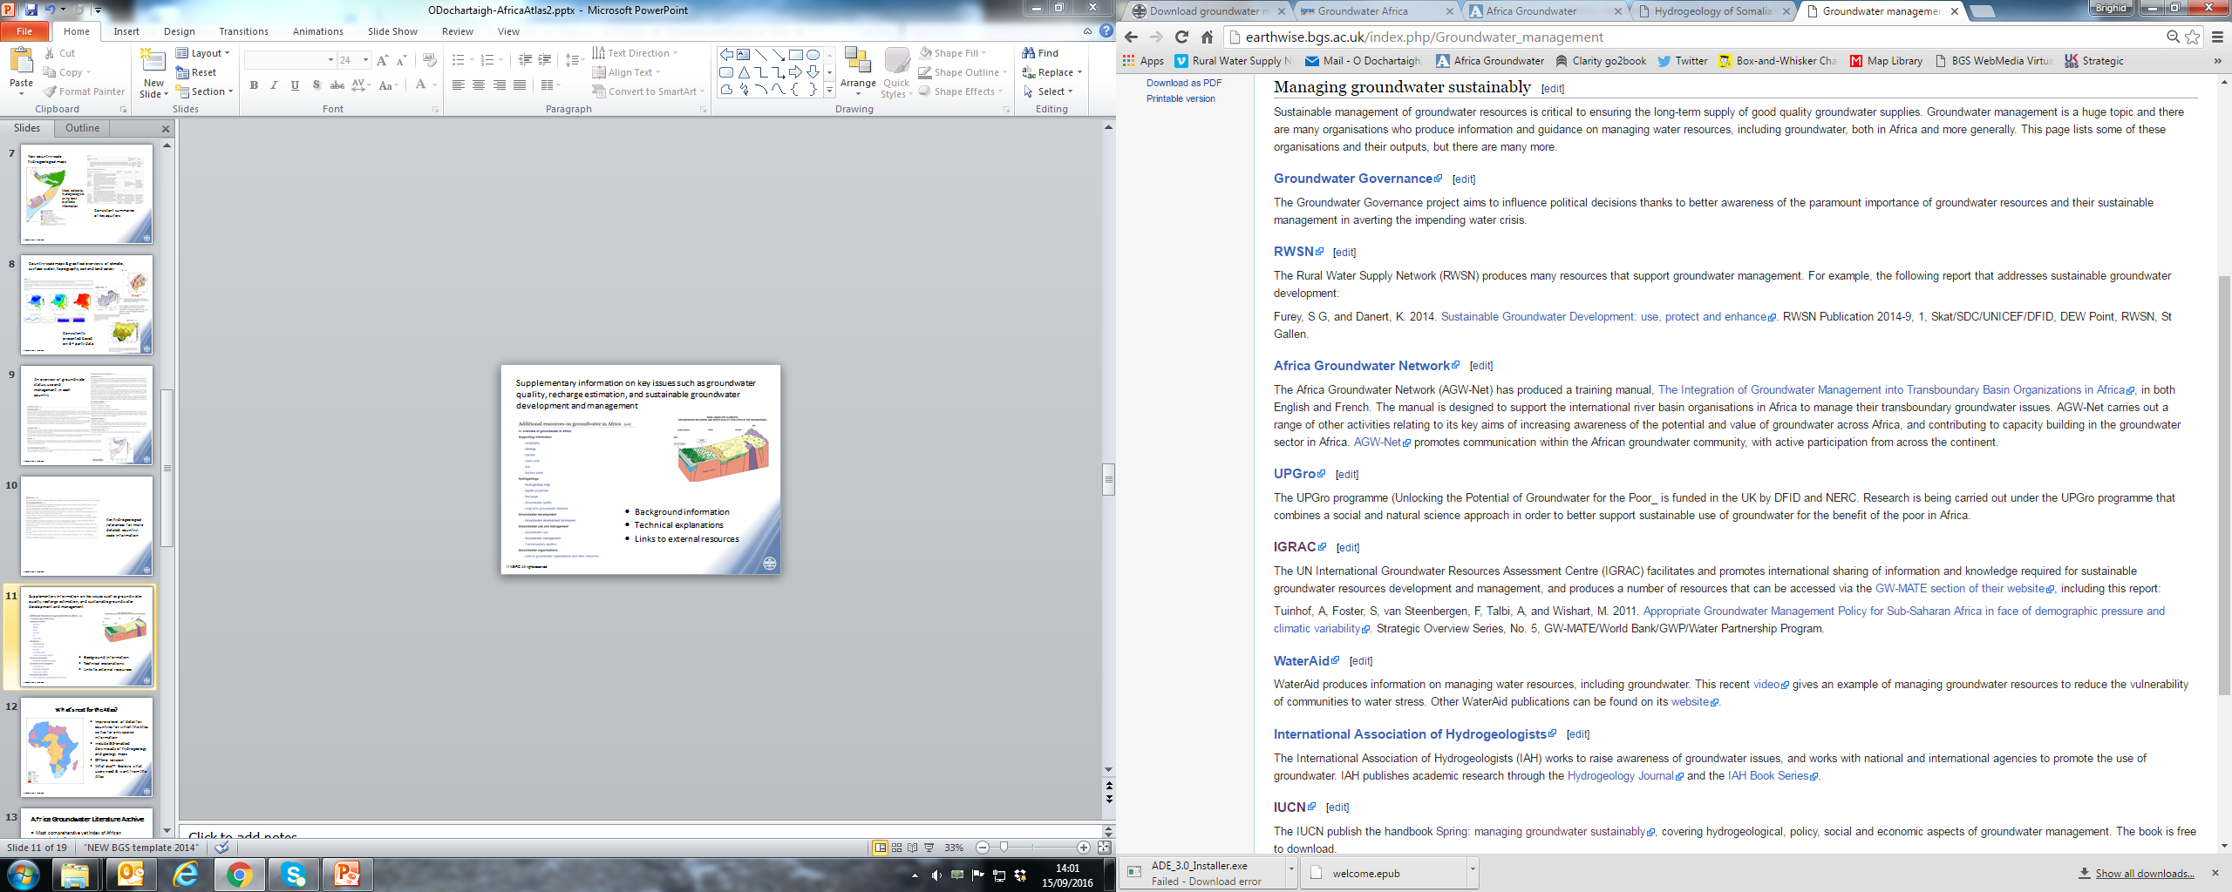
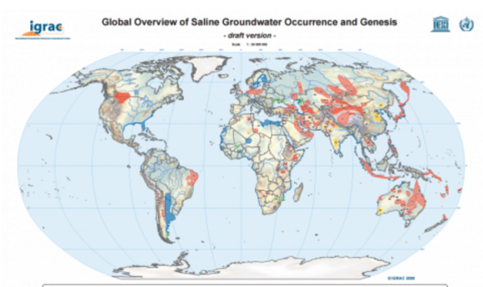
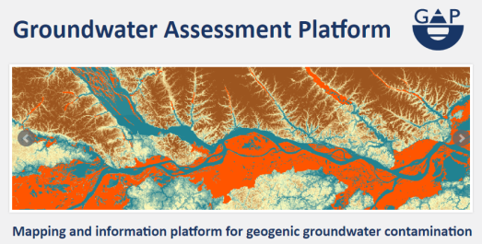
Resource Pages: background information, technical explanations & links to external resources
Key issues like groundwater use & quality; recharge estimation; sustainable groundwater development & management

Slide 12
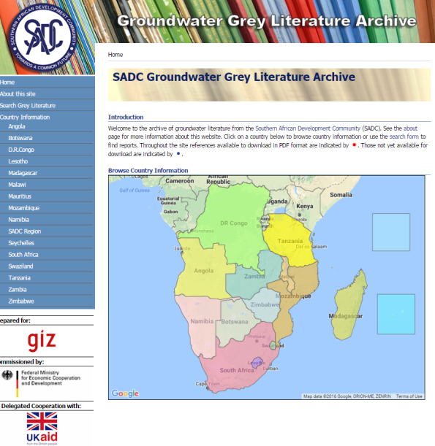
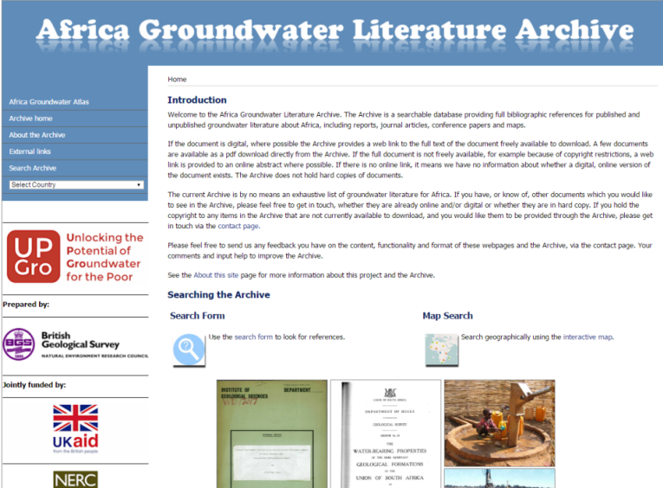
Africa Groundwater Literature Archive
  The most comprehensive yet index of African groundwater literature
  ~7000 entries (so far)
  Full text download if available; or for copyrighted documents, link to online abstract if available
  Full bibliographic references
  Builds on SADC Grey Literature Archive
  Complements other archives: e.g. WRC; IRD

Slide 13
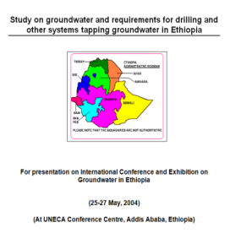
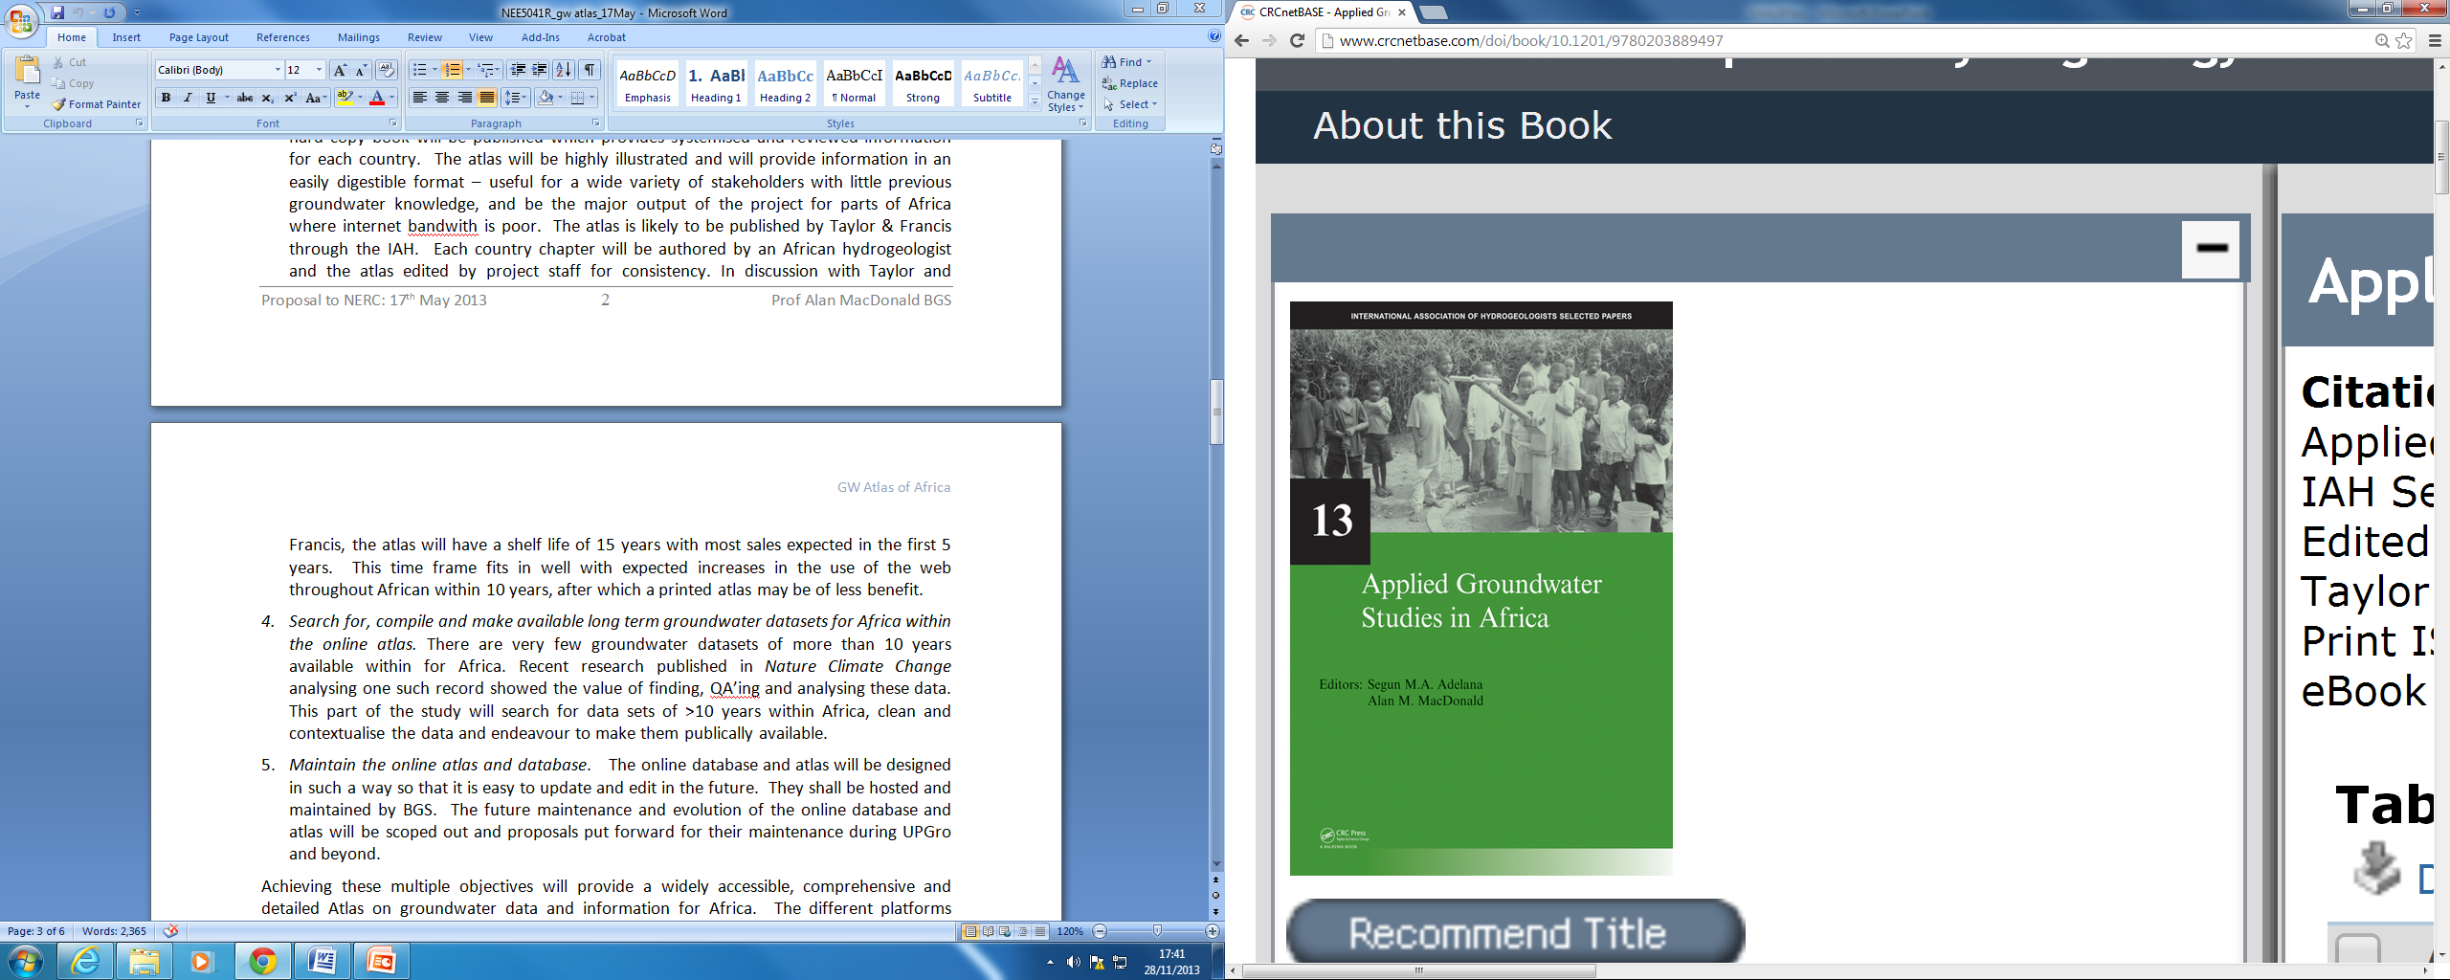
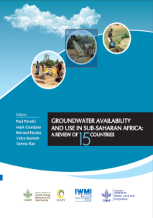
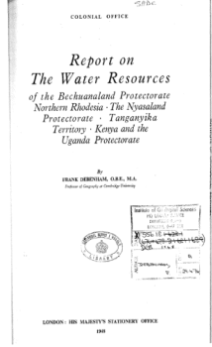
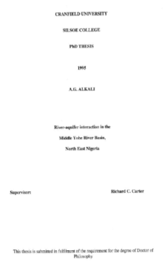
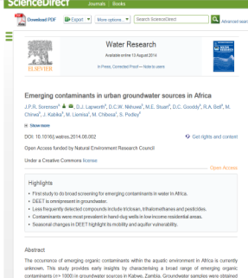
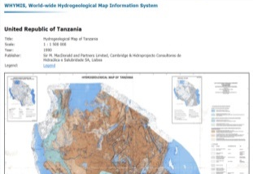


What’s in the Archive?
    Unpublished reports (full texts), 1897-2014 (e.g. by geological surveys; governments; development organisations)
    Journal articles, 1927-2014 (URL to online article &/or abstract)
    Conference papers, academic theses, books & book sections (URL to online text if available)
    Hydrogeological maps (pdf or image files; or URL to online file)

Slide 14





Using the Archive
  Powerful search options:
  Thematic keyword: >200 hydrogeological keywords
  Free text: Search or Filter Results by Title & Authors
  Geographically:
    Every relevant reference tagged by country
    As many as possible georeferenced & searchable on interactive map

Slide 15

What’s next for the Atlas and Archive?
Improve level of detail for countries currently with only sparse information
Include GIS downloads of hydrogeology & geology maps
Offline Atlas version
Update Archive with more hard-to-access groundwater documents
Explore with users what further developments they’d like to see

Slide 16

Available online now!
  http://www.bgs.ac.uk/africagroundwateratlas

