Slide 1

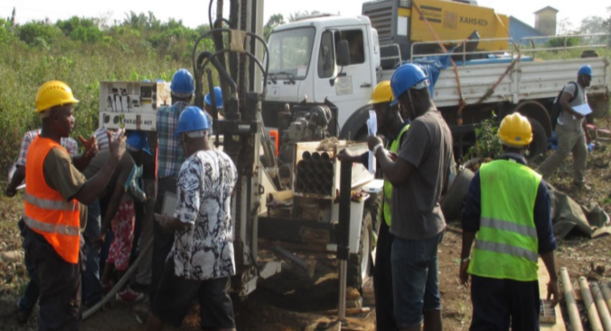

Professional Water Well Drilling in Africa: Incentives and Support
Sean Furey, Dr Kerstin Danert - Skat Foundation/Rural Water Supply Network (RWSN)
Jose Gesti Canuto - UNICEF

Slide 2
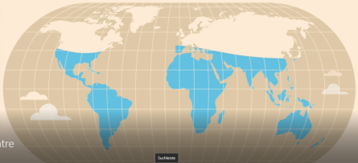
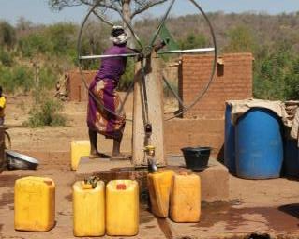
GROUNDWATER DEVELOPMENT
Dependence on groundwater for domestic supply: 45% globally / 75% in Africa
Potential of groundwater development for irrigation: additional 20-49% in Africa
Borehole construction key for achievement of SDG 6 (and beyond)
Notes:
It is estimated that 45% of the global population depends on groundwater for domestic use. In Africa, groundwater dependence is even higher, estimated at over 75%. Dispersed populations and communities within the continent are particularly reliant on groundwater, with hand dug wells historically playing a major role in rural and peri-urban areas. There is also considerable dependence on groundwater for urban water-supplies, particularly in Nigeria.
Groundwater use for irrigation is also forecast to increase. The potential for further development of irrigated agriculture fed by renewable groundwater is considerable, estimated to be between 20% and 49% of the cropland of the continent.
There is no doubt that groundwater supplies and boreholes in particular will play a tremendous role in achieving the SDGs in Africa. In rural areas, as countries gradually improve supply coverage, new sources are required in difficult-to-reach locations and tough hydrogeological conditions where the risks of drilling a dry borehole are high. Managing this uncertainty is one of the challenges of meeting the SDG drinking water target.

Slide 3
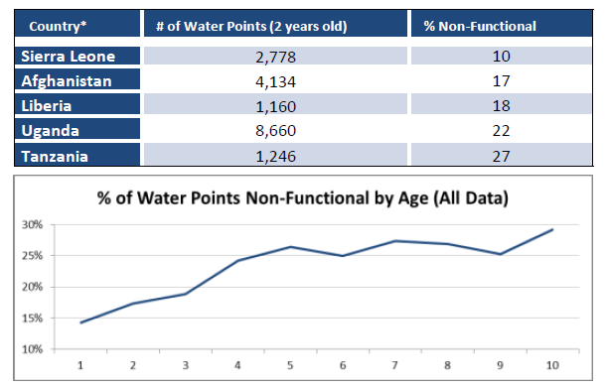

SUSTAINABILITY IS A CONCERN
DROP OF FUNCTIONALITY OF WATER POINTS BY AGE:
10-27% OF WATER POINTS NON FUNCTIONAL AFTER 1-2 YEARS
Source: Banks and Furey 2016
Notes:
So, we are discussing the importance of groundwater development and borehole construction to achieve universal access. But we can say that the drive for numbers of users over the last 15 years has led to a fall in the quality of project implementation. If the emphasis is on large numbers of boreholes and the capacity to properly manage implementation (NOT EVEN POST CONSTRUCTION) is neglected, construction quality suffers.
Different estimates give us an idea of how much sustainability of water points is a key concern:
RWSN (2009): between 10% and 65% of handpumps in 20 African countries were non-functional at the time of spot check.
Studies in 2013, 2015 and 2016: non-functionality rates between 14% and 26%
What we can see in the figure is a comparison of functionality of water points in 4 countries with their age. The figure shows that functionality falls as the age rises. While this is to be expected, the drop in functionality to 70-85% in the first one to two years is a real cause for concern.

Slide 4
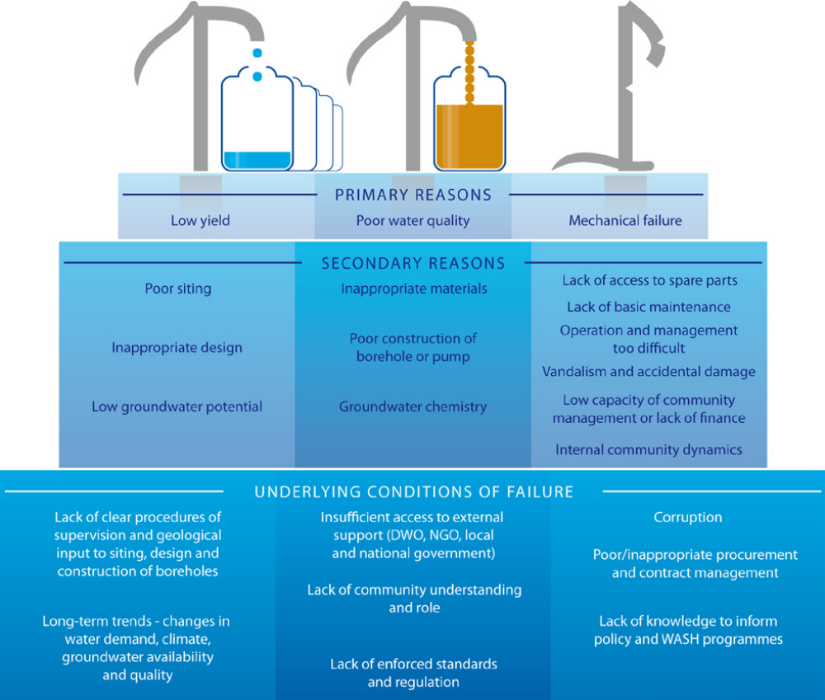

UNDERLYING CAUSES OF FAILURE
SECONDARY REASONS
Lack of access to spare parts
Lack of basic maintenance
Operation and management too difficult
Vandalism and accidental damage
Low capacity of community management
Poor siting
Inappropriate design
Low groundwater potential
Inappropriate materials
Poor construction of borehole or pump
Groundwater chemistry
UNDERLYING CONDITIONS OF FAIL
Lack of clear procedures of supervision and geological input to siting, design and construction of boreholes
Long term trends – changes in water demand, climate, groundwater availability and quality
Insufficient access to external support (NGO, local and national government)
Lack of community understanding
Lack of enforced standards and regulation
Corruption
Poor/inappropriate contract management
Lack of knowledge to inform policy and WASH programmes
SOURCE: BONSOR ET AL (2015)
Notes:
When boreholes fitted with pumps function poorly, and ultimately fail, the physical problems are typically:
Low yield, i.e. inadequate quantity of water or seasonal unreliability
Poor quality water (e.g. high turbidity, poor bacteriological/chemical quality)
Mechanical failure of the pump
On the whole, these physical problems are caused by one or more secondary reasons, as illustrated in the Figure. In turn, these secondary reasons are a consequence of other, deeper underlying causes.

Slide 5
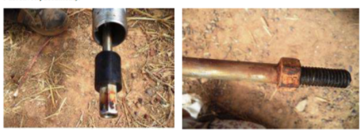
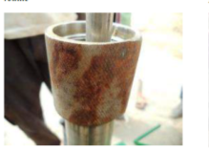
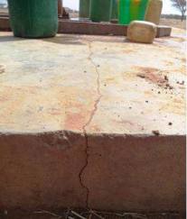
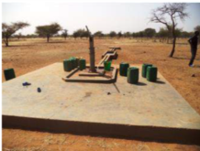
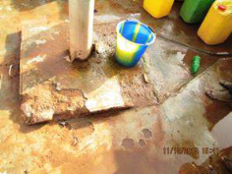

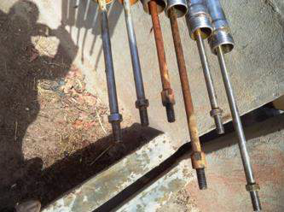
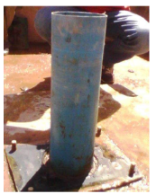
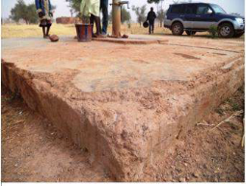
CONSTRUCTION Quality IS
NOT ALWAYS CONSISTENT
FIGURES BELOW: ONE-YEAR OLD INFRASTRUCTURE.
COUNTRY & PROGRAMME - ANONYMOUS

Slide 6
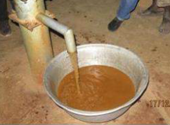
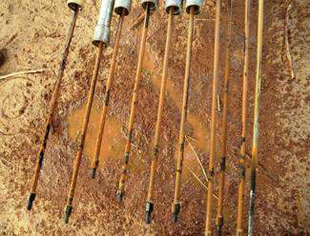
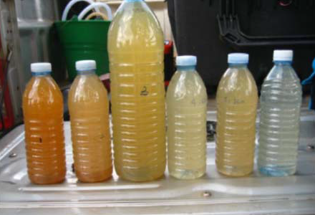
THERE MAY BE
WATER QUALITY
PROBLEMS
Including
pH
Iron and Manganese
Turbidity
Salinity
Fluoride
Arsenic
Nitrogen species (nitrate, nitrite and ammonium)
Bacteria
CORROSION

Slide 7

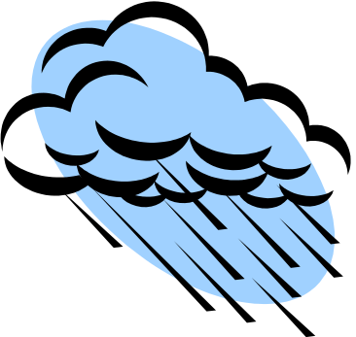
BURKINA FASO DRILLING Calendar
Reports
(and payments?)
Planning, budgeting and design
Siting, drilling, supervision and monitoring
m
j
j
a
o
s
m
a
n
d
f
j
Call for tender
Tender allocation
Rainy season: no access to boreholes nor drilling sites

Slide 8
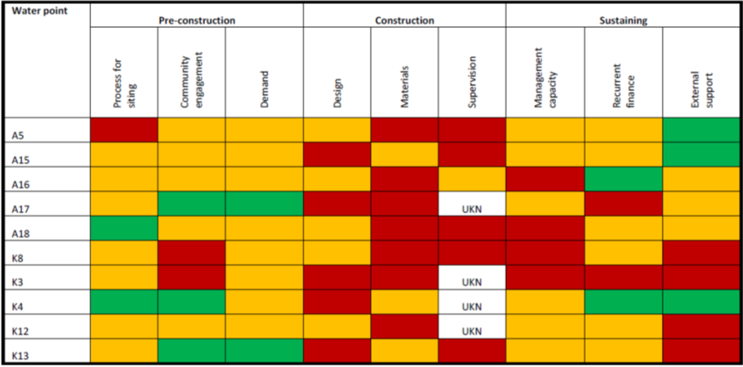
Causes of FAILURE
(UgANDA PILOT STUDY)
A traffic light scorecard approach indicating the status of different facets of water point implementation, BONSOR ET AL (2015)

Slide 9
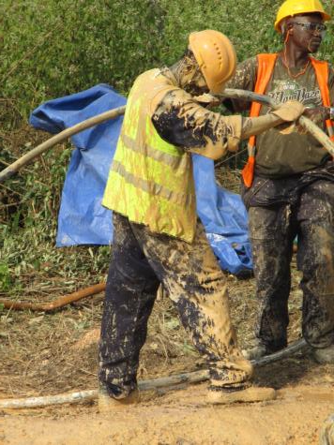
PROFESSIONALISM
Professionalism is the skill, good judgement and behaviour expected from a person or an organisation who can undertake a job well.

Slide 10
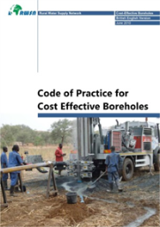
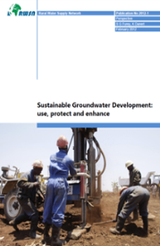
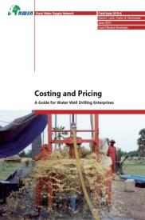
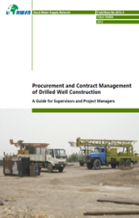
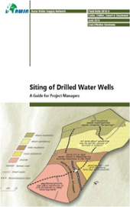
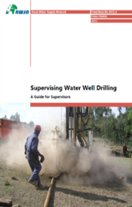
RAISING PROFESSIONALISM: what
http://www.rural-water-supply.net/en/resources-top/sort/year-desc/filter/2_9
Notes:
Improving drilling professionalism is not a one-off activity, but rather a process. It can take several years to raise standards, and it requires continued vigilance to uphold them. But the rewards of a professional drilling sector are enormous for a country’s economy, long-term prosperity and employment, and to meet the SDG drinking water targets.
Over the last years the partners supporting the sustainable groundwater development theme within the RWSN have focused on advance the thinking and developed manuals on borehole drilling. Broadly speaking, these documents focus on what to do. Now, recently much more attention has been paid to discuss how to raise professionalism of groundwater development.
The result of all this thinking is synthesized in the proposed 6 areas of engagement that you can see on the screen:
Institutional frameworks
Groundwater information
Project design, implementation and monitoring
Capacity
Investment
Dialogue & awareness
This cover most of the underlying reasons for failure that we have seen in the slide before.

Slide 11
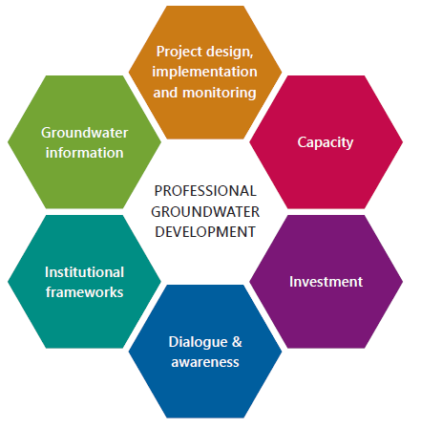
RAISING PROFESSIONALISM: how
http://www.rural-water-supply.net/en/resources/details/775
Source: UNICEF/Skat Foundation (2016)
Notes:
Improving drilling professionalism is not a one-off activity, but rather a process. It can take several years to raise standards, and it requires continued vigilance to uphold them. But the rewards of a professional drilling sector are enormous for a country’s economy, long-term prosperity and employment, and to meet the SDG drinking water targets.
Over the last years the partners supporting the sustainable groundwater development theme within the RWSN have focused on advance the thinking and developed manuals on borehole drilling. Broadly speaking, these documents focus on what to do. Now, recently much more attention has been paid to discuss how to raise professionalism of groundwater development.
The result of all this thinking is synthesized in the proposed 6 areas of engagement that you can see on the screen:
Institutional frameworks
Groundwater information
Project design, implementation and monitoring
Capacity
Investment
Dialogue & awareness
This cover most of the underlying reasons for failure that we have seen in the slide before.

Slide 12



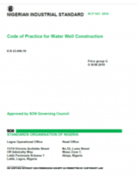
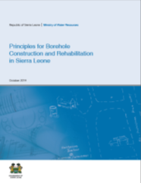













AREAS OF ENGAGEMENT (I)
Promote initiatives to:
Improve national (or state) policies, regulation, standards and procedures of borehole drilling
Clarify roles and responsibilities
Institutional frameworks
?
?
?
?
?
Notes:
Institutional framework – promote initiatives to improve national (or state) policies, regulation, standards and procedures of borehole drilling, including the clarification of roles and responsibilities.
Groundwater information – value groundwater data and ensure that drilling records are collected, quality-assured and collated. This data, together with information generated from it, must be made readily available to help inform future borehole siting and design, as well as groundwater resources management.

Slide 13


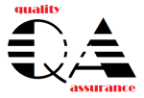

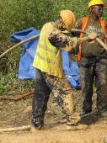
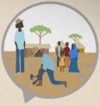
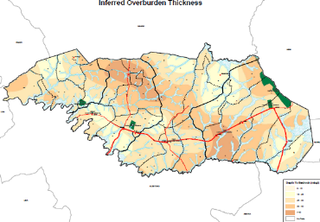
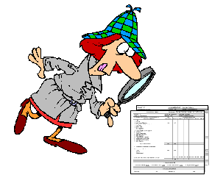
AREAS OF ENGAGEMENT (II)
Institutional frameworks
Promote initiatives to:
Ensure drilling records are collected, quality-assured and collated
Make this readily available to inform future borehole siting, design, and groundwater management
Groundwater information
Notes:
Institutional framework – promote initiatives to improve national (or state) policies, regulation, standards and procedures of borehole drilling, including the clarification of roles and responsibilities.
Groundwater information – value groundwater data and ensure that drilling records are collected, quality-assured and collated. This data, together with information generated from it, must be made readily available to help inform future borehole siting and design, as well as groundwater resources management.

Slide 14
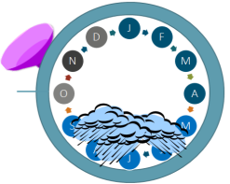
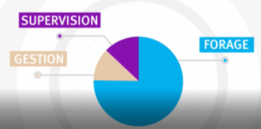


AREAS OF ENGAGEMENT (III)
Promote initiatives to:
Improve the design, implementation (including supervision) & monitoring of specific projects
Ensure that documentation of the process and results is readily available
Project design, implementation and monitoring
Notes:
Project design, implementation and monitoring – improve the design, implementation and monitoring of specific borehole drilling or rehabilitation projects, and ensure that documentation of the process and results is readily available.
Capacity – raise the skills and knowledge of groundwater development and encourage the availability of suitable equipment in the country.

Slide 15

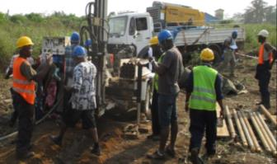
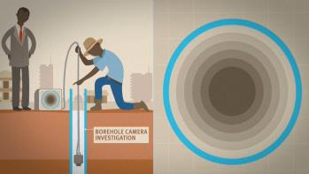
AREAS OF ENGAGEMENT (IV)
Project design, implementation and monitoring
Promote initiatives to:
Raise the skills and knowledge of groundwater development practitioners
Encourage the availability of suitable equipment in the country
Capacity
Notes:
Project design, implementation and monitoring – improve the design, implementation and monitoring of specific borehole drilling or rehabilitation projects, and ensure that documentation of the process and results is readily available.
Capacity – raise the skills and knowledge of groundwater development and encourage the availability of suitable equipment in the country.

Slide 16



AREAS OF ENGAGEMENT (V)
Promote initiatives to:
Foster dialogue between government agencies, drilling contractors, consultants, NGOs, development partners and civil society
Raise awareness of decision-makers and the public about groundwater potential management
Dialogue & awareness
Investment
Notes:
Dialogue & awareness – foster dialogue between government agencies (including regulators), drilling contractors and consultants, NGOs, development partners and civil society. Encourage and support efforts that raise awareness of decision-makers and the public about groundwater potential, management and its exploitation.
Investment – invest adequate financial resources to improve and sustain professional groundwater development.

Slide 17
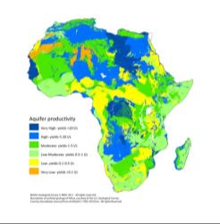

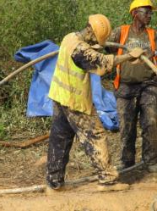
AREAS OF ENGAGEMENT (VI)
Dialogue & awareness
Promote initiatives to:
Invest adequate financial resources to improve and sustain professional groundwater development
Investment
Notes:
Dialogue & awareness – foster dialogue between government agencies (including regulators), drilling contractors and consultants, NGOs, development partners and civil society. Encourage and support efforts that raise awareness of decision-makers and the public about groundwater potential, management and its exploitation.
Investment – invest adequate financial resources to improve and sustain professional groundwater development.

Slide 18
ANIMATED FILMS
Siting: The importance of good borehole siting - https://vimeo.com/130738245 Les forages: l’importance de bien choisir le site d’implantation - https://vimeo.com/126795160
Supervision: A borehole that lasts for a lifetime https://vimeo.com/130747716 Un forage qui dure toute une vie - https://vimeo.com/128478995
Construction quality: Why are some boreholes better than others? . https://vimeo.com/185292448 Pourquoi certains forages sont-ils meilleurs que d’autres? - https://vimeo.com/185289895
Procurement and contract management: Four steps to better drilling contracts - https://vimeo.com/185287147 Quatre étapes pour de meilleurs contrats de forage https://vimeo.com/171751215

Slide 19
References
BONSOR, H.C, OATES, N., CHILTON, P.J., CARTER, R.C, CASEY, V., MACDONALD, A.M., CALOW, R. ALOWO, R. WILSON, P., TUMUTUNGIRE , M.,BENNIE, M. (2015b) A hidden crisis: strengthening the evidence base on the sustainability of rural groundwater supplies: results from a pilot study in Uganda. British Geological Survey, 85pp. (Unpublished), Available from: http://www.bgs.ac.uk/
MACDONALD A.M, BONSOR, H.C, O’DOCHARTAIGH, B.É. AND TAYLOR, R.G (2012) Quantitative maps of groundwater resources in Africa, Environmental Research Letters, 7 (2012), doi:10.1088/1748-9326/7/2/024009
UNICEF/Skat Foundation (2016) Professional Water Well Drilling: A UNICEF Guidance Note, Cost Effective Boreholes Partnership of the Rural Water Supply Network by UNICEF and Skat Foundation, Available from www.unicef.org and www.rural-water-supply.net

Slide 20




Download GUIDANCE NOTE from: http://www.rural-water-supply.net/en/resources/details/775
Join RWSN: http://dgroups.org/RWSN
– Thank You –
Kerstin Danert kerstin.danert@skat.ch
Jose Gesti Canuto jgesticanuto@unicef.org
Sean Furey sean.furey@skat.ch

