Slide 1
What is the Status of Groundwater Science in Africa?
Daniel Olago,
University of Nairobi

Slide 2
Africa Water Vision
Africa Water Vision for the Year 2025
“An Africa where there is an equitable and sustainable use and management of water resources for poverty alleviation, socio-economic development, regional cooperation, and the environment.”
WatSan Targets
75% reduction of the populations having no access to a hygienic and suitable system of drinking water-supply and sanitation before 2015. [MDG]
Reduce by 95% the populations having no access to a hygienic and suitable system of drinking water-supply and sanitation before 2025. [AWV]

Slide 3
Africa’s Science and Technology Consolidated Plan of Action 2006
Vision: an Africa well integrated into the global economy and free of poverty
Some of the Focal Areas
Improving infrastructure for R&D and promote sharing of such facilities;
Strengthening the continent’s human skills base by increasing the number of scientists, technicians and engineers;
Building a strong political & civil society constituency for S&T in Africa;
Promoting the application of S&T to achieve specific MDGs (sic. SDGs)

Slide 4
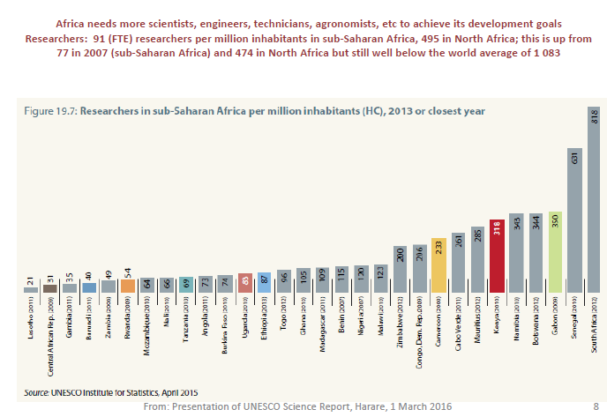
Economic Diversification in Africa Hampered by a Skills Shortage

Slide 5
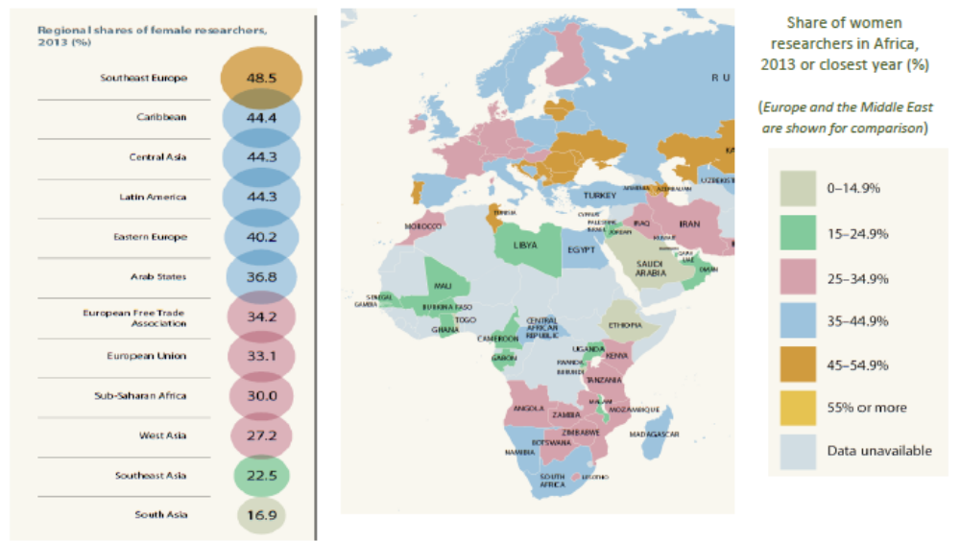
Three out of 10 Sub-Saharan Researchers is a Woman

Slide 6
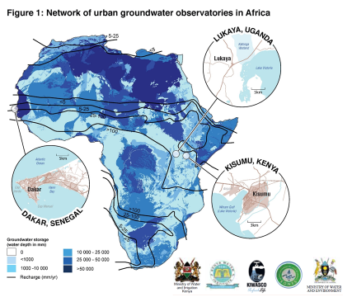
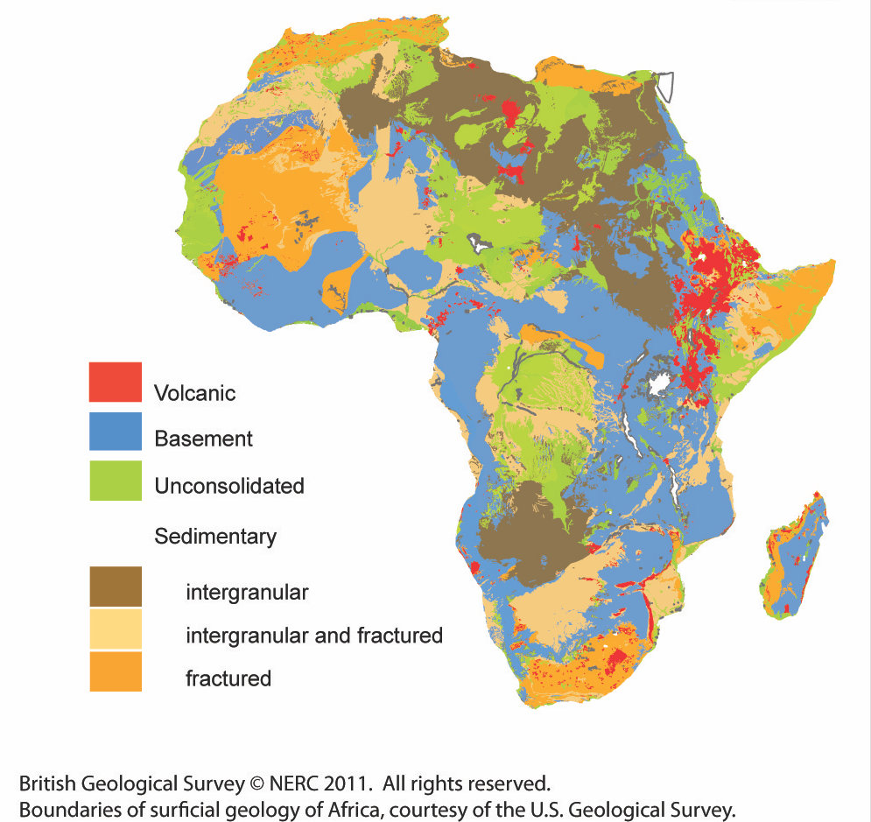
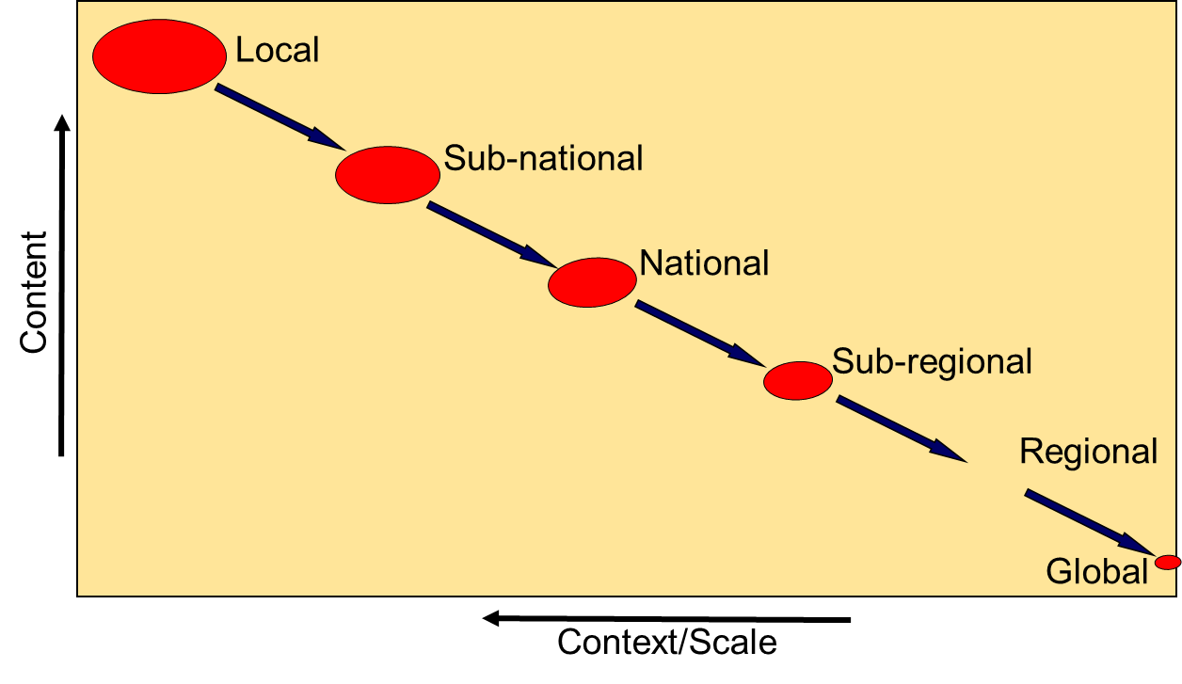
Scales – Coarse to Fine
LARGE SCALE: Regional & sub-regional aquifer systems

Slide 7
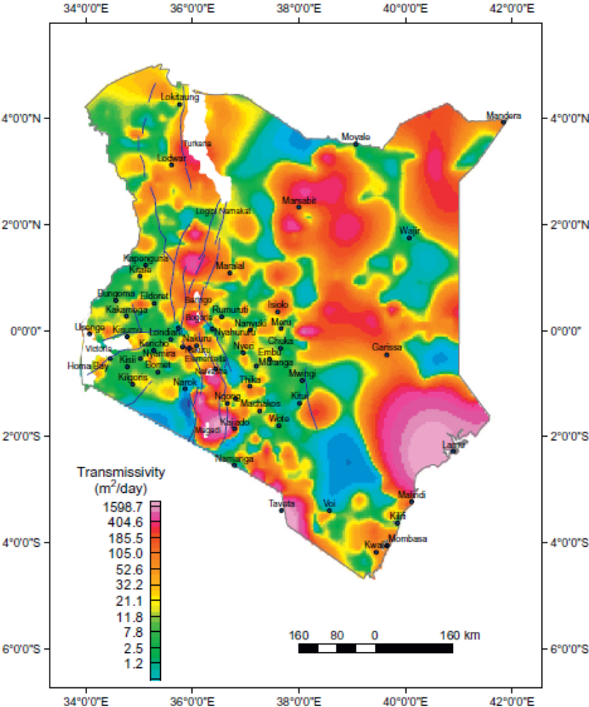
Scales – Coarse to Fine
Low borehole density
Groundwater bodies mostly only partially described
Insufficient or not maintained monitoring data (groundwater, surface water, climate, land use change)
Insufficient abstraction data
Few hydrogeological and even less groundwater vulnerability maps
High
borehole density
Kuria, 2013. In: Paron et al. (Eds) Kenya: A Natural Outlook - Geoenvironmental Resources and Hazards. Developments in Earth Surface Processes, 16.
INTERMEDIATE SCALE: National to sub-national or small transboundary systems

Slide 8
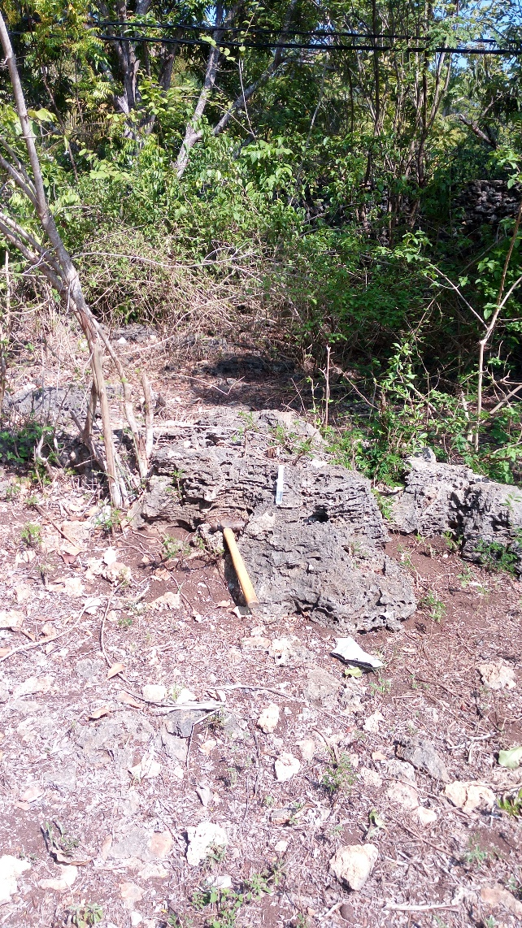
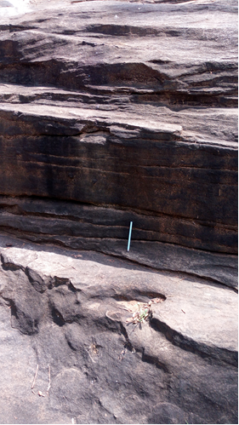
Typical Assessment Approaches
Typical approach:
Limited literature review
Assess old geological maps for rock type and structures
Carry out VES / ERT at a point location
Data interpretation & Reporting
Project approach:
Systems approach to aquifer studies
Assess existing geological & related info & carry out detailed field mapping
Determine the regional-local geo-evolutionary trend
Determine sites for 2D geophysics & integrate with geology data

Slide 9
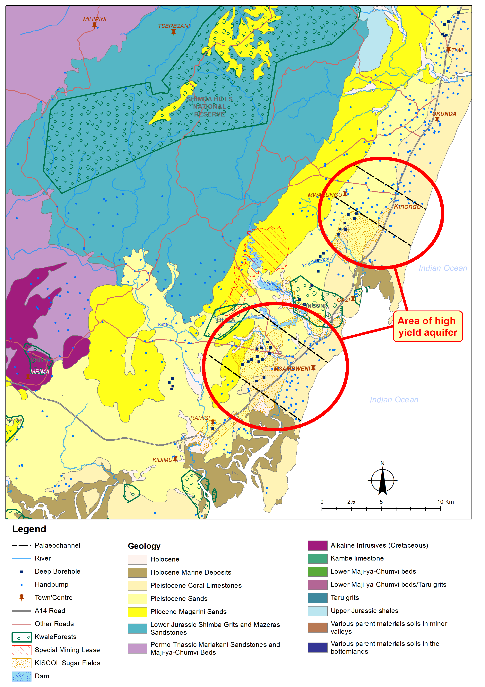
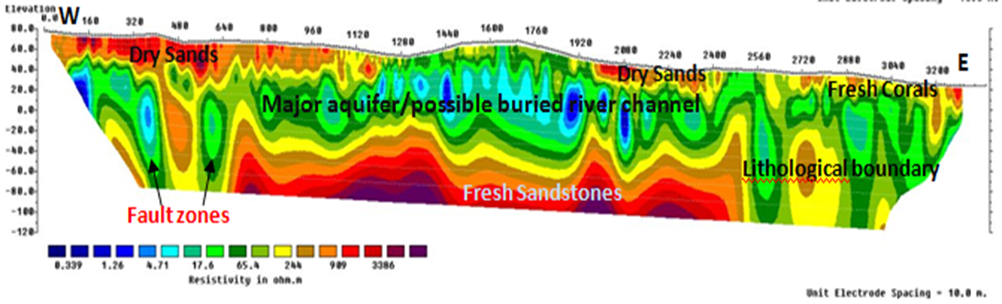
Investing in Groundwater Studies Avoids Costly Mistakes – Kwale (Gro for GooD Project)
Geology/Geophysics supports the structure and development of the GW model
Provides data on aquifer geometry and hydraulic properties
SMALL SCALE: County to local systems

Slide 10
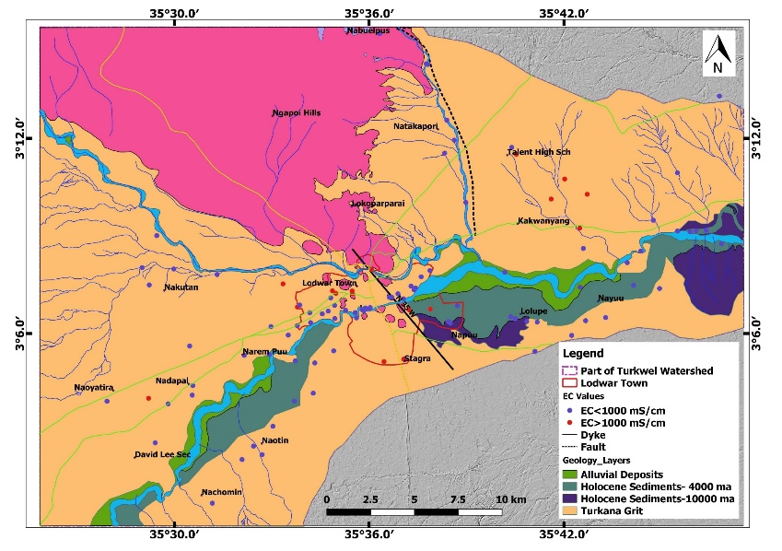
Investing in Groundwater Studies Avoids Costly Mistakes (Lodwar Town, REACH Programme)

Slide 11
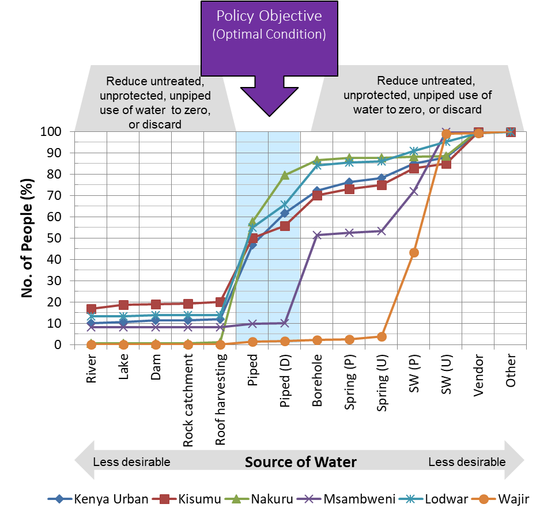
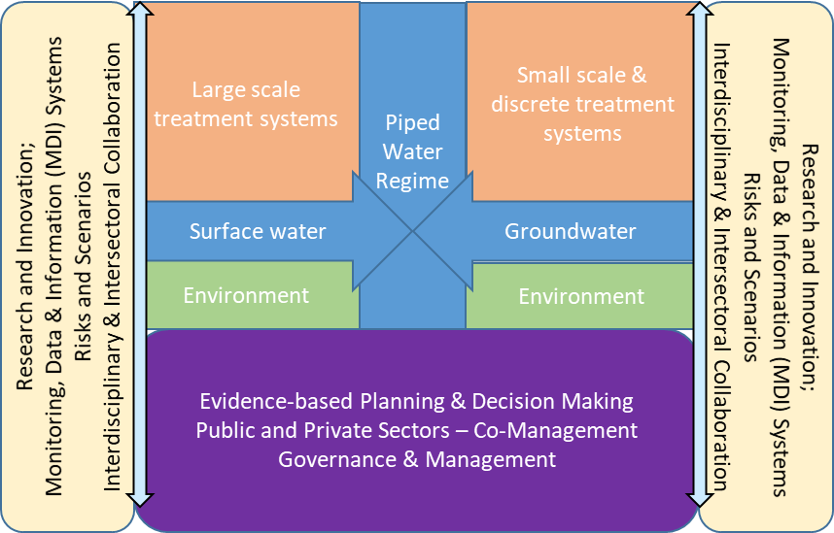
Groundwater Research & Development for Water Security – A Systems & Scaled Approach
Olago, 2018: Hydrogeology Journal, https://doi.org/10.1007/s10040-018-1895-y

